Slide 1



Global Carbon Budget
2022
2025
The GCP is a Global
Research Project of
and a Research
Partner of
Published on 13 November 2025
PowerPoint version 0.6

Slide 2
Acknowledgements
The work presented here has been possible thanks to the enormous observational and modelling efforts of the institutions and networks below
Atmospheric CO₂ datasets
NOAA/GML (Lan et al., 2025)
Scripps (Keeling et al., 1976)
Atmospheric O₂ datasets
Scripps (Keeling 2025)
Fossil CO₂ emissions
Andrew and Peters, 2025
CDIAC-FF (Erb and Marland, 2025)
UNFCCC 2025
Energy Institute 2025
Consumption emissions
Peters et al., 2011
GTAP (Narayanan et al., 2015)
Land-use change
BLUE (Hansis et al., 2015)
OSCAR (Gasser et al., 2020)
LUCE (Qin et al., 2024)
GFED4 (van der Werf et al., 2017)
FAO-FRA and FAOSTAT
HYDE (Klein Goldewijk et al., 2017)
LUH2 (Hurtt et al., 2020)
MapBiomas (Souza et al., 2020)
Land models
CABLE-POP | CLASSIC | CLM6.0 | CLM-FATES | DLEM | eDV3 | ELM | ELM-FATES | GDSTEM | IBIS | iMAPLE | ISAM | JSBACH | JULES-ES | LPJ-GUESS | LPJmL | LPJ-EOSIM | LPX-Bern | OCN | ORCHIDEEv3 | SDGVM | VISIT | VISIT-UT | CARDAMOM
Climate forcing CRU (Harris et al., 2014) | JRA-55 (Kobayashi et al., 2015)
Ocean models
NEMO-PlankTOM12 | NEMO4.2-PISCES (IPSL) | MICOM-HAMOCC (NorESM1-OCv1.2) | MPIOM-HAMOCC6 | NEMO3.6-PISCESv2-gas (CNRM) | FESOM2.1-REcoM3 | MOM6-COBALTv3 (Princeton) | CESM-ETHZ | MRI-ESM2-3 | ACCESS (CSIRO)
fCO₂ based ocean flux products
VLIZ-SOMFFN | Jena-MLS | CMEMS-LSCE-FFNNv2 | UExP-FNN-U | NIES-ML3 | JMA-MLR | OceanSODA-ETHZv2 | LDEO-HPD | CSIR-ML6
Surface Ocean CO₂ Atlas SOCATv2025
Atmospheric inversions
Jena CarboScope | CarbonTracker Europe (CTE) | NISMON-CO2 | CT-NOAA | CMS-Flux | CAMS-Satellite | GONGGA | COLA | GCASv2 | UoE | MIROC-ACTM | NTFVAR | THU | NISMON-CO2_GOSAT
Earth system models
CanESM5 | EC-Earth3-CC | IPSL-CM6A-CO2-LR | MIROC-ES2L | MPI-ESM1-2-LR | NorCPM-CC
Full references provided in Friedlingstein et al 2025

Slide 3
Contributors 133 people | 102 organisations | 21 countries
P Friedlingstein | M O'Sullivan | MW Jones | RM Andrew | DCE Bakker | J Hauck
P Landschützer | C Le Quéré | H Li | IT Luijkx | GP Peters | W Peters | J Pongratz
C Schwingshackl | S Sitch | JG Canadell | P Ciais
K Aas | SR Alin | P Anthoni | L Barbero | NR Bates | N Bellouin | A Benoit-Cattin | CF Berghoff
R Bernardello | L Bopp | IB Brasika | MA Chamberlain | N Chandra | F Chevallier | LP Chini | NO Collier
TH Colligan | M Cronin | L Djeutchouang | X Dou | MP Enright | K Enyo | M Erb | W Evans | RA Feely | L Feng
DJ Ford | A Foster | F Fransner | T Gasser | M Gehlen | T Gkritzalis | J Goncalves De Souza | G Grassi
L Gregor | N Gruber | B Guenet | Ö Gürses | K Harrington | I Harris | J Heinke | GC Hurtt | Y Iida | T Ilyina
A Ito | AR Jacobson | AK Jain | T Jarníková | A Jersild | F Jiang | SD Jones | E Kato | RF Keeling
K Klein Goldewijk | J Knauer | Y Kong | J Korsbakken | C Koven | T Kunimitsu | X Lan | Z Liu | J Liu | Z Liu
C Lo Monaco | L Ma | G Marland | PC McGuire | GA McKinley | J Melton | N Monacci | E Monier | EJ Morgan
JD Müller | DR Munro | S Nakaoka | LR Nayagam | Y Niwa | T Nutzel | A Olsen | AM Omar | N Pan | S Pandey
D Pierrot | Z Qin | PA Regnier | G Rehder | L Resplandy | C Rödenbeck | A Roobaert | TM Rosan | J Schwinger
R Séférian | I Skjelvan | TL Smallman | V Spada | MG Sreeush | Q Sun | AJ Sutton | C Sweeney
D Swingedouw | S Takao | H Tatebe | H Tian | X Tian | B Tilbrook | H Tsujino | F Tubiello
SJ Van de Velde | G van der Werf | E Van Ooijen | A Walker | R Wanninkhof | X Yang | W Yuan | X Yue | J Zeng
Atlas Team Members at LSCE, France
P Ciais | P Brockmann
Communications Team
A Hayward | A Morrison
C Bartman | K Mansell

Slide 4

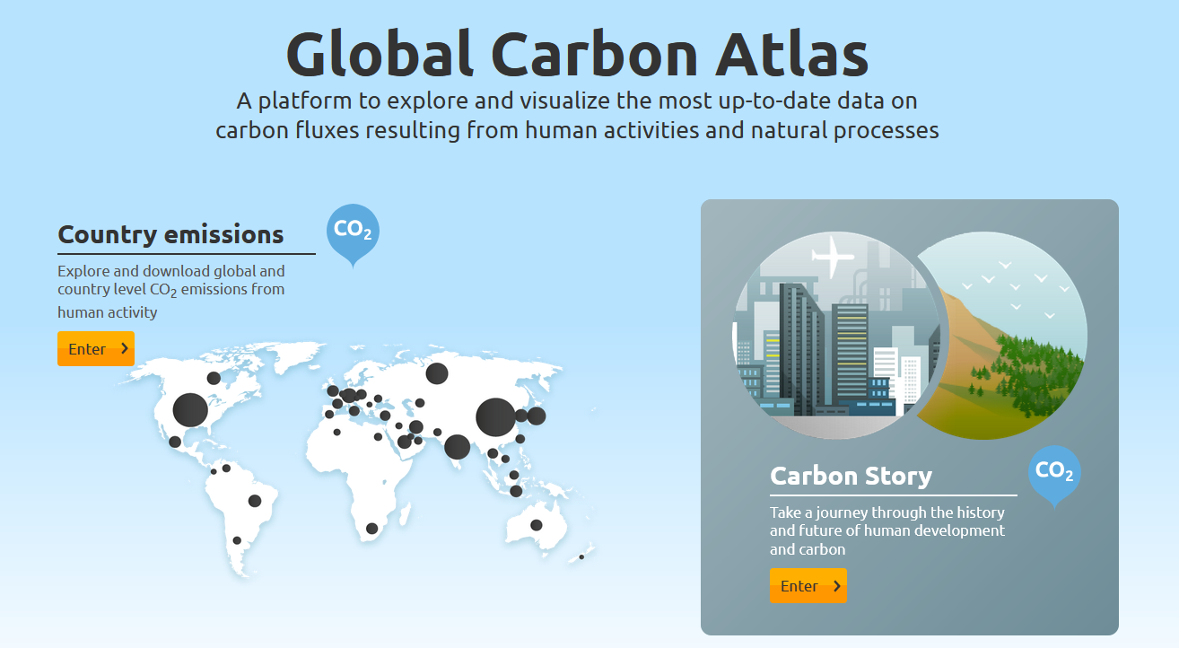
Data Access and Additional Resources
More information, data sources and data files:
https://globalcarbonbudget.org/carbonbudget
More information, data sources and data files:
www.globalcarbonatlas.org
(co-funded in part by BNP Paribas Foundation)

Slide 5
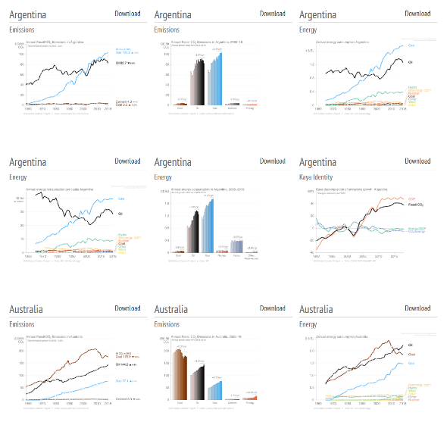
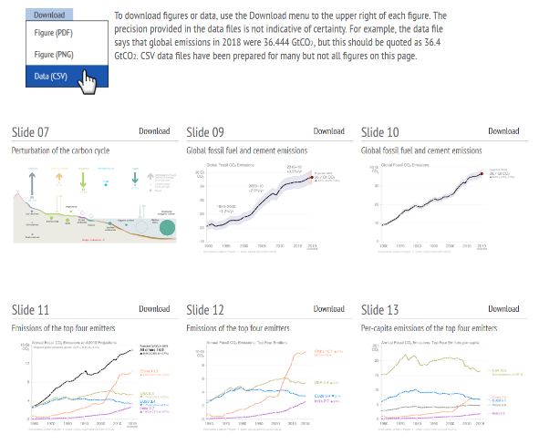
Download of figures and data
Global Carbon Budget
Additional country figures
Figures and data for most slides available from tinyurl.com/GCB25figs
and from https://globalcarbonbudget.org/carbonbudget

Slide 6
All the data is shown in billion tonnes CO₂ (GtCO₂)
1 Gigatonne (Gt) = 1 billion tonnes = 1×10¹⁵g = 1 Petagram (Pg)
1 kg carbon (C) = 3.664 kg carbon dioxide (CO₂)
1 GtC = 3.664 billion tonnes CO₂ = 3.664 GtCO₂
(Figures are available from https://globalcarbonbudget.org/carbonbudget)
Most figures in this presentation are available for download as PNG, PDF and SVG files
from tinyurl.com/GCB25figs along with the data required to reproduce them.
Disclaimer
The Global Carbon Budget and the information presented here are intended for those interested in learning about the carbon cycle, and how human activities are changing it. The information contained herein is provided as a public service, with the understanding that the Global Carbon Project team make no warranties, either expressed or implied, concerning the accuracy, completeness, reliability, or suitability of the information.

Slide 7

License
Our intention is that these figures and data are used. That’s why they’re released under the Creative Commons Attribution 4.0 International license. Simply put, you may freely copy and modify these figures and data, and use them in both commercial and non-commercial works, as long as you give credit to the Global Carbon Project.
If you’re just tweeting a figure or using a figure in a presentation, then it already says at the bottom that it’s by the Global Carbon Project, so you’re good to go! If you use the data directly or modify the figure, then you will need to make sure the attribution is in place.
For details on the license, visit the Creative Commons website.
Suggested citation for use in a book: “Used with permission of the Global Carbon Project under the Creative Commons Attribution 4.0 International license.”

Slide 8
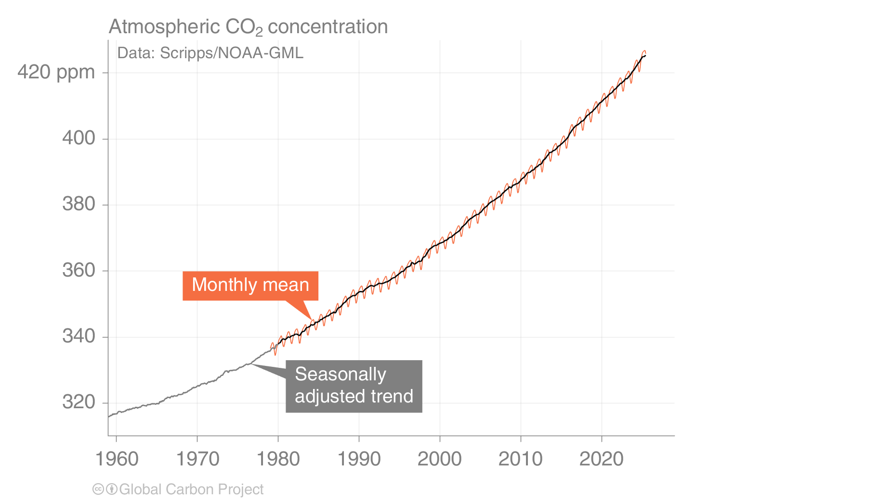
Atmospheric CO₂ concentration
The global CO₂ concentration increased from ~277 ppm in 1750 to 422.8 ppm in 2024 (up 53%)
Globally averaged surface atmospheric CO₂ concentration. Data from: NOAA-GML after 1980;
the Scripps Institution of Oceanography before 1980
Source: NOAA-GML; Scripps Institution of Oceanography; Friedlingstein et al 2025; Global Carbon Project 2025

Slide 9
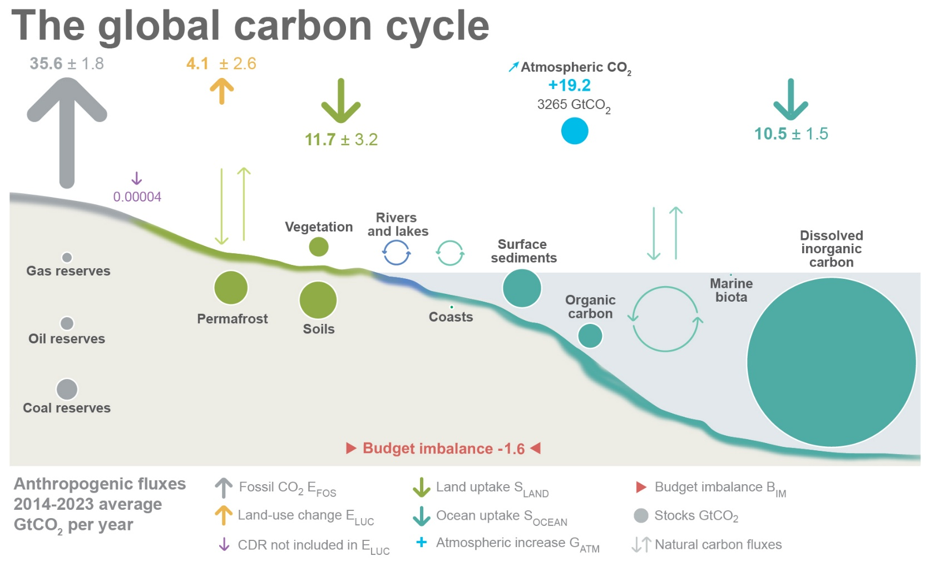
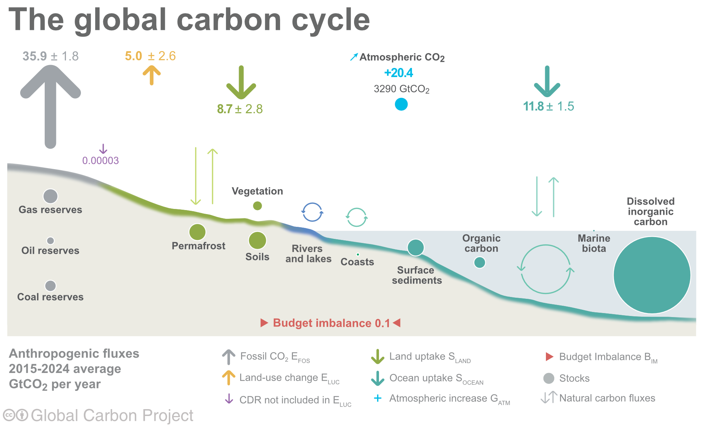
Anthropogenic perturbation of the global carbon cycle
Perturbation of the global carbon cycle caused by anthropogenic activities,
global annual average for the decade 2015–2024 (GtCO₂/yr)
CDR here refers to Carbon Dioxide Removal besides those associated with land-use that are accounted for in the Land-use change estimate.
The budget imbalance is the difference between the estimated emissions and sinks.
Source: NOAA-GML; Friedlingstein et al 2025; Global Carbon Project 2025

Slide 10
Key Highlights in 2025

Slide 11
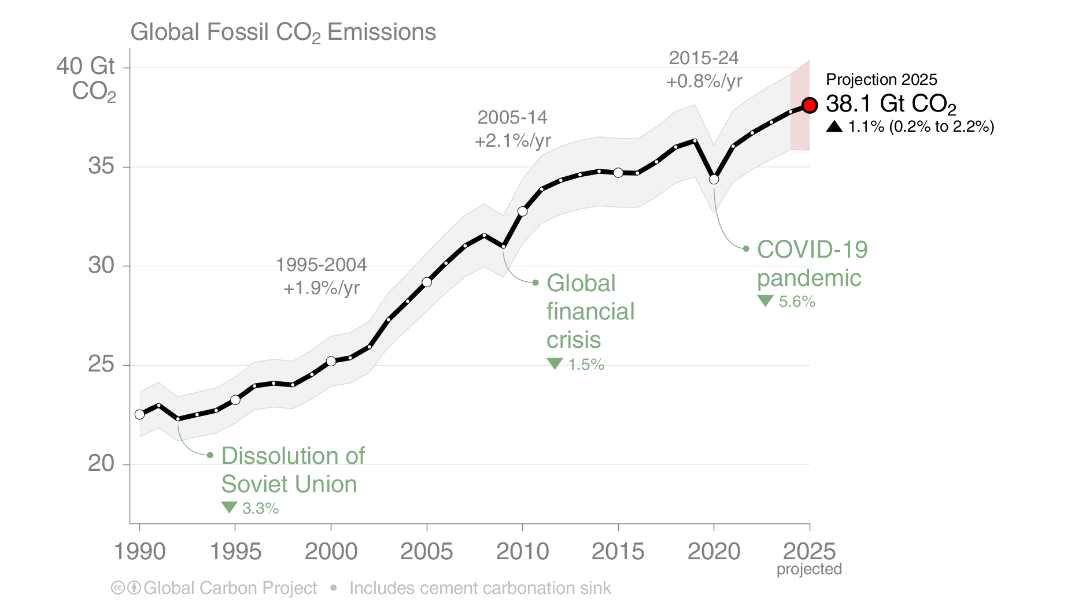
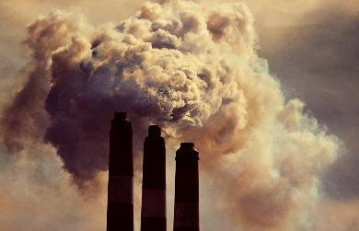
Global Fossil CO₂ Emissions
Global fossil CO₂ emissions: 37.8 ± 2 GtCO₂ in 2024, 69% over 1990
Projection for 2025: 38.1 ± 2 GtCO₂, 1.1% [0.2% to +2.2%] higher than 2024
Uncertainty is ±5% for one standard deviation (IPCC “likely” range)
The 2025 projection is based on preliminary data and modelling. The global total includes a cement carbonation sink of 0.8 GtCO₂.
Source: Friedlingstein et al 2025; Global Carbon Project 2025

Slide 12
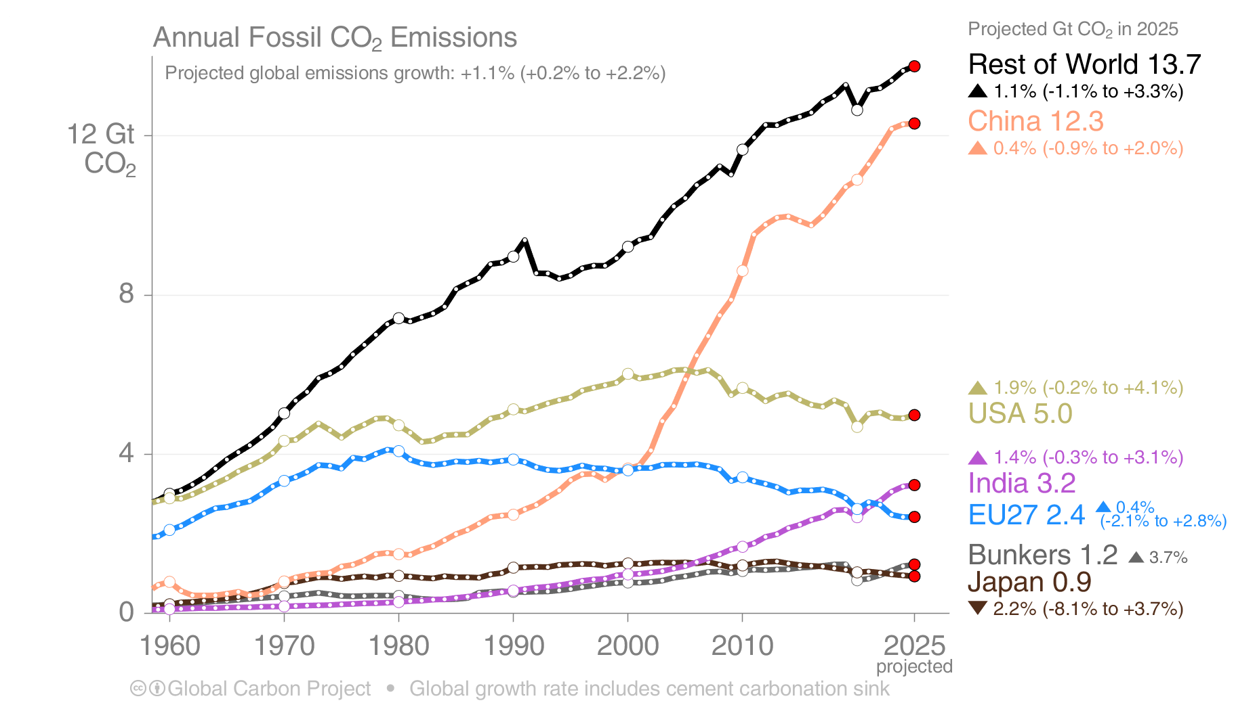
Emissions Projections for 2025
Fossil CO₂ emissions growth is from different regions in 2025 compared to 2024:
The USA rising, and EU27 flat, reversing recent declines. China flat, India low growth, contrasting recent strong growth.
The 2025 projections are based on preliminary data and modelling.
‘Bunkers’ are fossil fuels used for international shipping and aviation
Source: Friedlingstein et al 2025; Global Carbon Project 2025

Slide 13
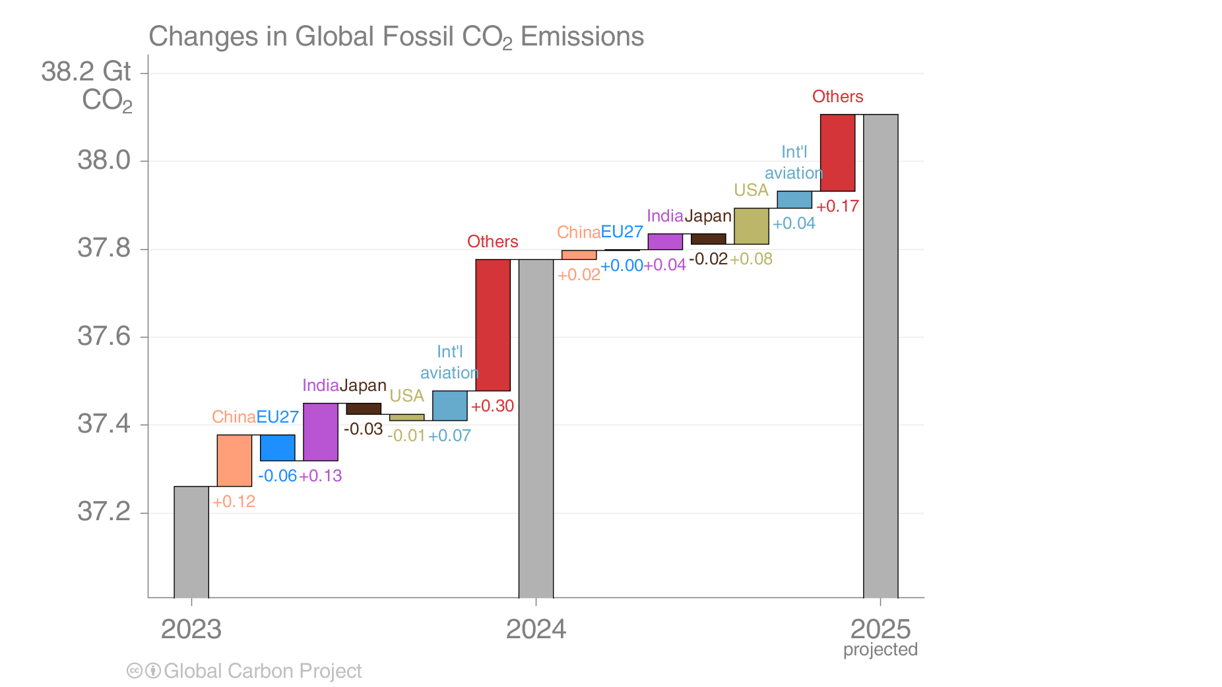
Fossil CO₂ emissions growth: 2023–2025
Emissions are projected to increase in USA and India, be flat to slight rise in China and the EU, decline in Japan,
with growth in international aviation and the combined rest of the world (Others) in 2025
The 2025 projections are based on preliminary data and modelling.
Source: Friedlingstein et al 2025; Global Carbon Project 2025

Slide 14
Summary of fossil CO₂ emissions in 2024 and 2025
Region / Country | 2024 emissions (billion tonnes/yr) | 2024 growth (percent) | 2025 projected emissions growth (percent) | 2025 projected emissions (billion tonnes/yr)
China | 12.3 | 0.7% | 0.4% | 12.3
USA | 4.9 | -0.6% | 1.9% | 5.0
India | 3.2 | 4.0% | 1.4% | 3.2
EU27 | 2.4 | -2.6% | 0.4% | 2.4
Japan | 1.0 | -2.8% | -2.2% | 0.9
International bunkers* | 1.2 | 9.8% | 3.7% | 1.2
All others | 13.6 | 1.6% | 1.1% | 13.7
World | 38.6 | 1.0% | 1.0% | 38.9
World (incl. cement carbonation) | 37.8 | 1.1% | 1.1% | 38.1
*Emissions from use of international aviation and maritime shipping bunker fuels are not usually included in national totals.
Cement carbonation sink only included in global (World) estimate.
Source: Friedlingstein et al 2025; Global Carbon Project 2025

Slide 15
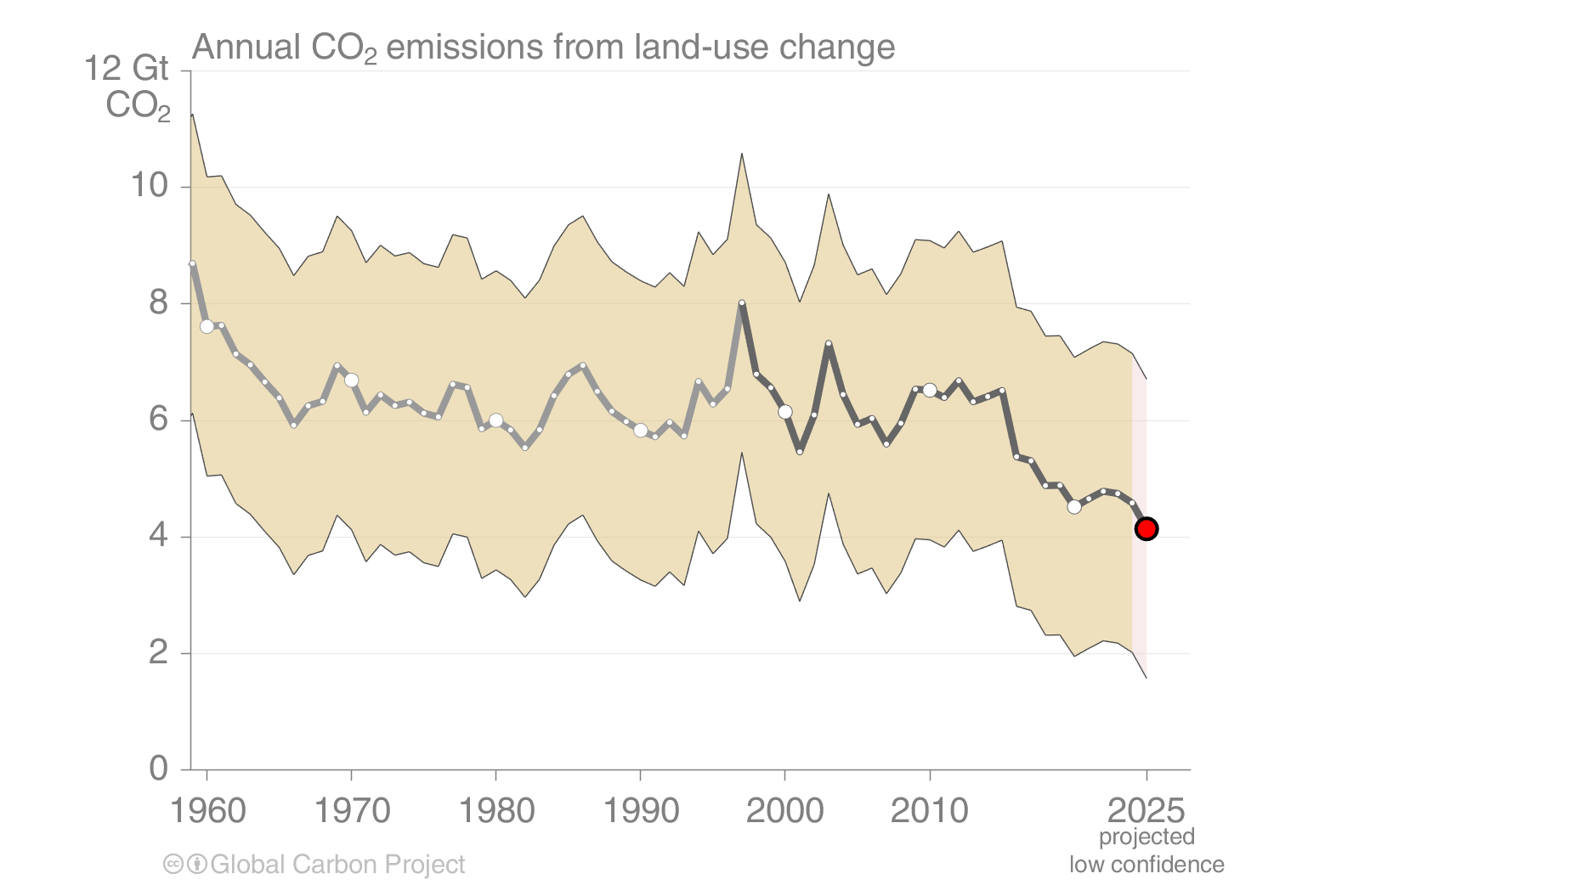
Land-use change emissions
Land-use change emissions are 5.0 ± 2.6 GtCO₂ per year for 2015–2024, and show a negative trend in the last two decades,
but estimates are still highly uncertain. Projection for 2025: 4.1 ± 2.6 GtCO₂
Indonesian fires
Estimates from three bookkeeping models
Source: Friedlingstein et al 2025; Global Carbon Project 2025

Slide 16
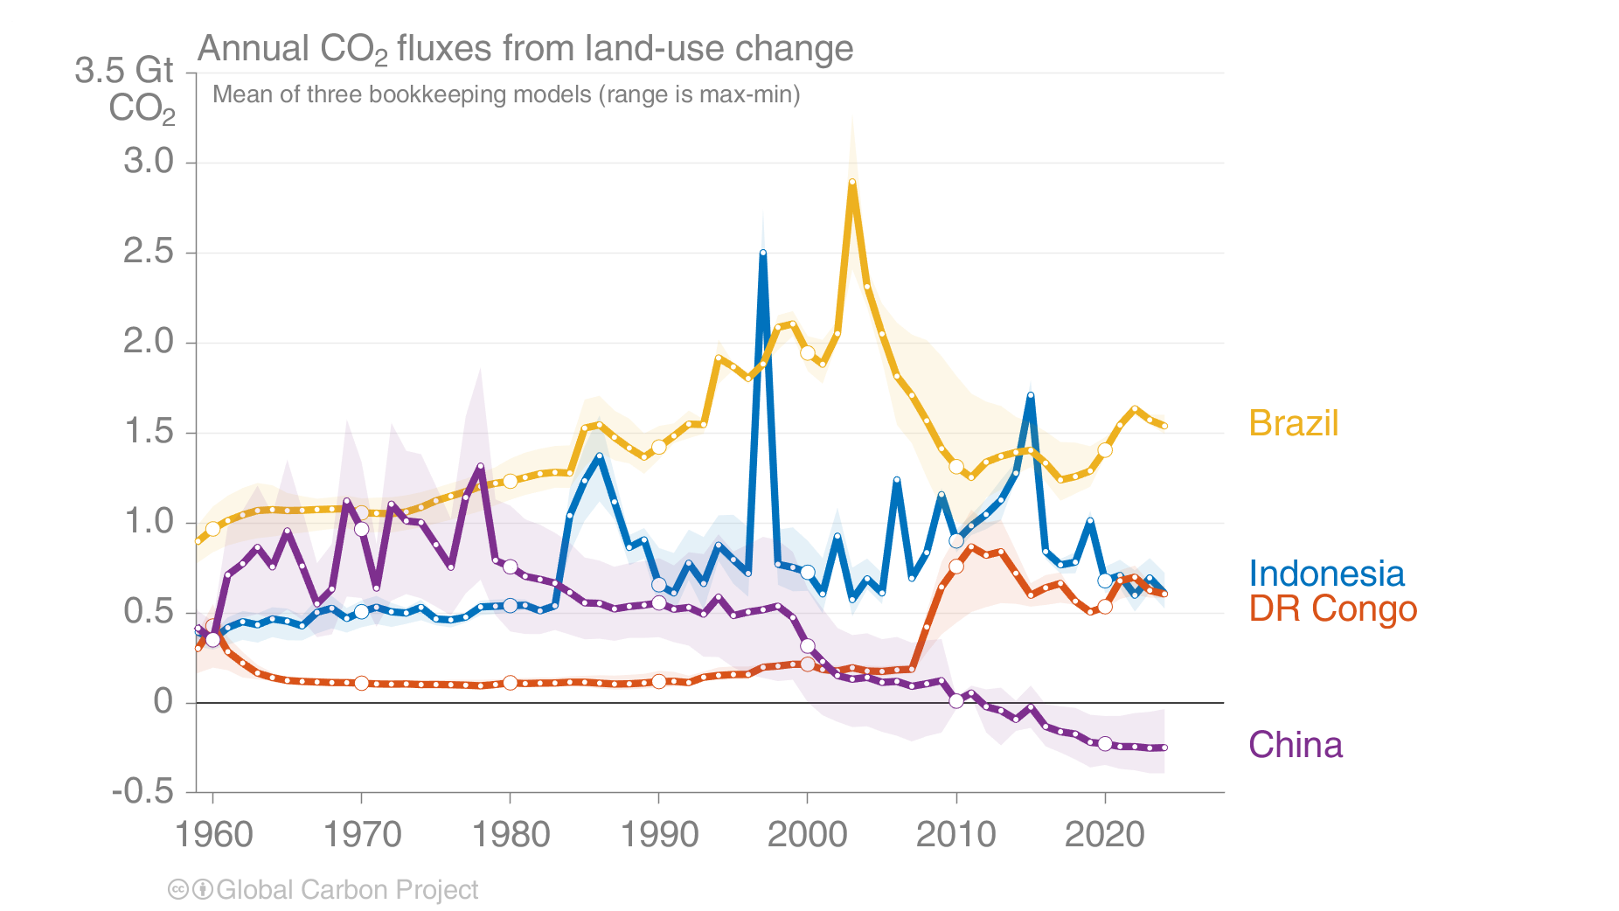
Land-use change emissions
Combined land-use change emissions from Brazil, Indonesia, and the DR Congo make up over half of the global net land-use change emissions. China moved from being a top emitter during 1960–1980 to the largest net remover in 2015–2024.
Estimates from three bookkeeping models
Source: Friedlingstein et al 2025; Global Carbon Project 2025

Slide 17
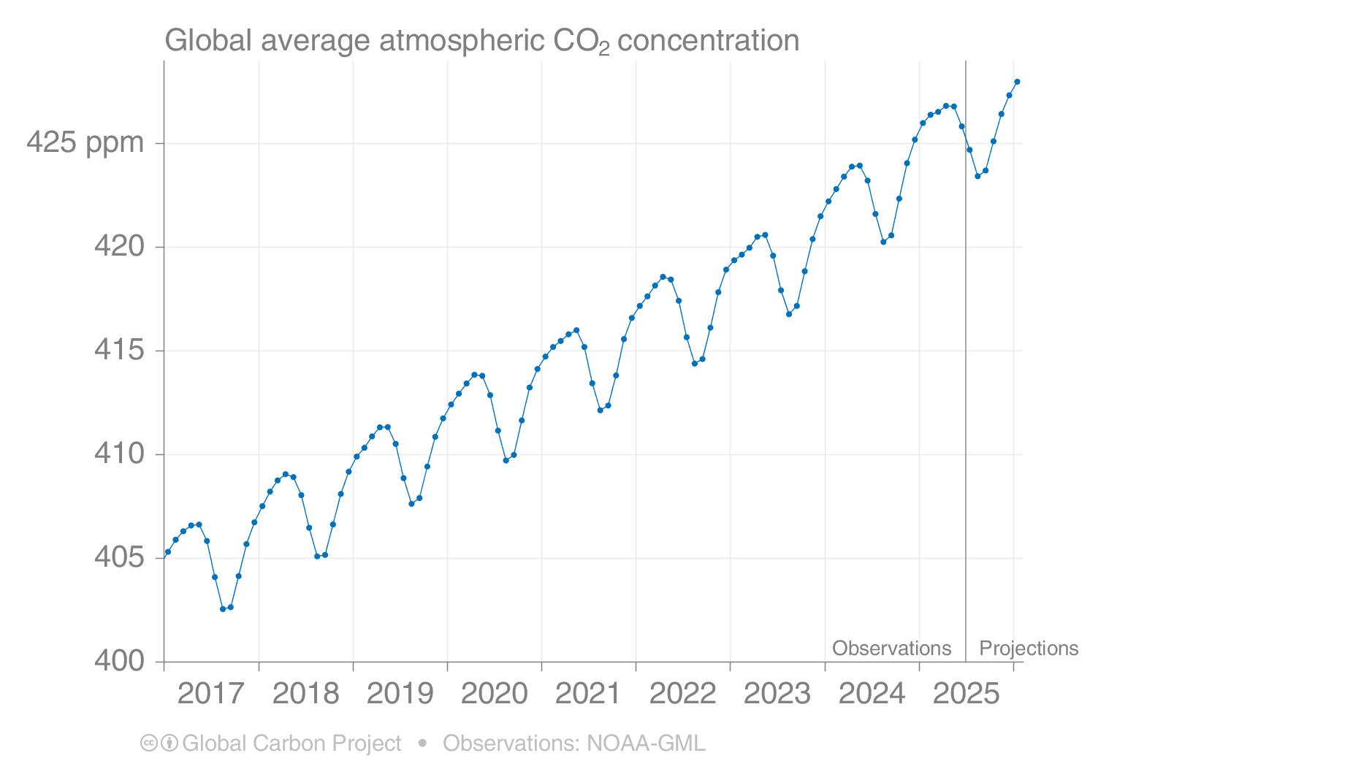
Forecast of global atmospheric CO₂ concentration
The global atmospheric CO₂ concentration is forecast to average 425.7 parts per million (ppm) in 2025, increasing by 2.3 ppm.
Source: Friedlingstein et al 2025; Global Carbon Project 2025

Slide 18
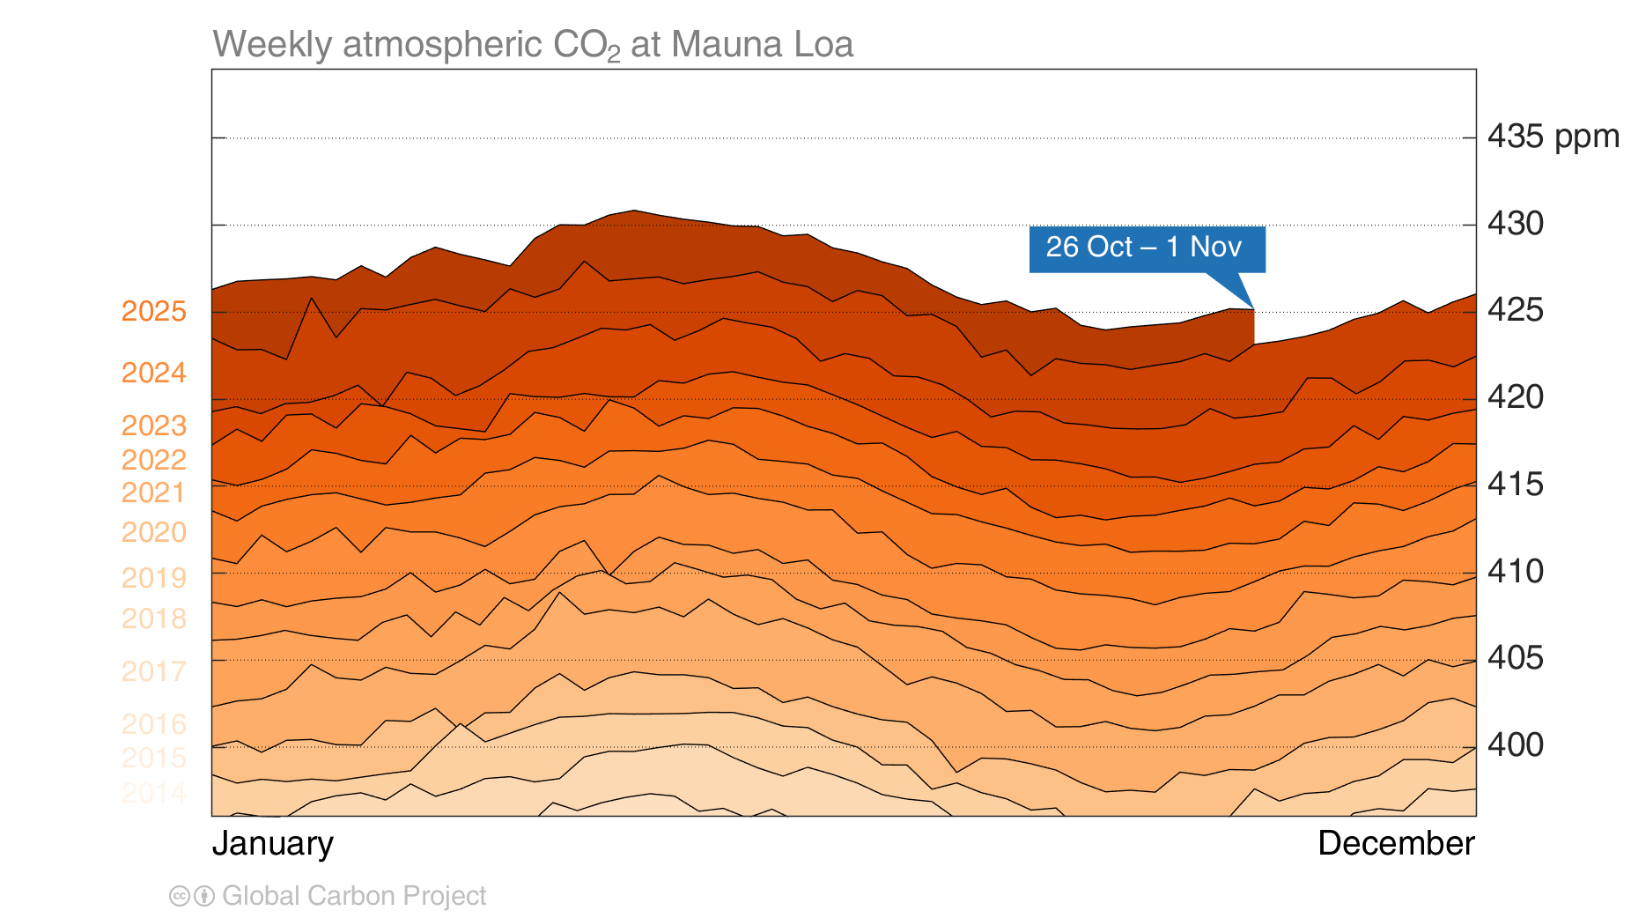
Mauna Loa atmospheric CO₂
Atmospheric CO₂ concentration has increased every single year,
including in 2020 – despite the drop in fossil CO₂ emissions – because of continued emissions
Source: Friedlingstein et al 2025; Global Carbon Project 2025

Slide 19
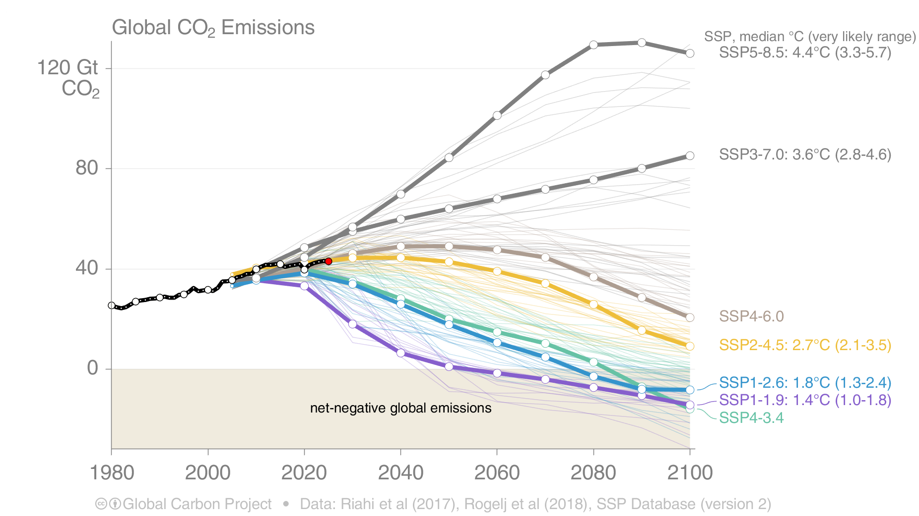
Shared Socioeconomic Pathways (SSPs)
The SSPs were designed to span the range of potential outcomes. Total CO₂ emissions are currently tracking in the middle of the range. The temperature outcomes are based on assessed scenarios in IPCC AR6 Working Group I.
This set of quantified SSPs are based on the output of six Integrated Assessment Models (AIM/CGE, GCAM, IMAGE, MESSAGE, REMIND, WITCH).
Net emissions include those from land-use change and bioenergy with CCS.
Source: Riahi et al. 2016; Rogelj et al. 2018; IIASA SSP Database; IAMC; Global Carbon Project 2025

Slide 20
Global fossil CO₂ emissions

Slide 21
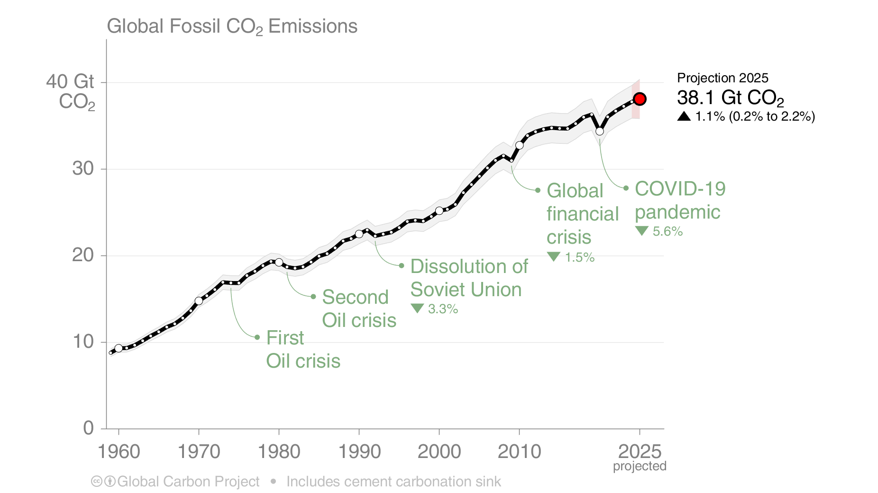
Global fossil CO₂ emissions
Global fossil CO₂ emissions have risen steadily over the last decades.
Emissions are set to grow 1.1% in 2025, after growing 1.1% in 2024, and 0.8%/yr from 2015 to 2024.
The 2025 projection is based on preliminary data and modelling.
Source: Friedlingstein et al 2025; Global Carbon Project 2025

Slide 22
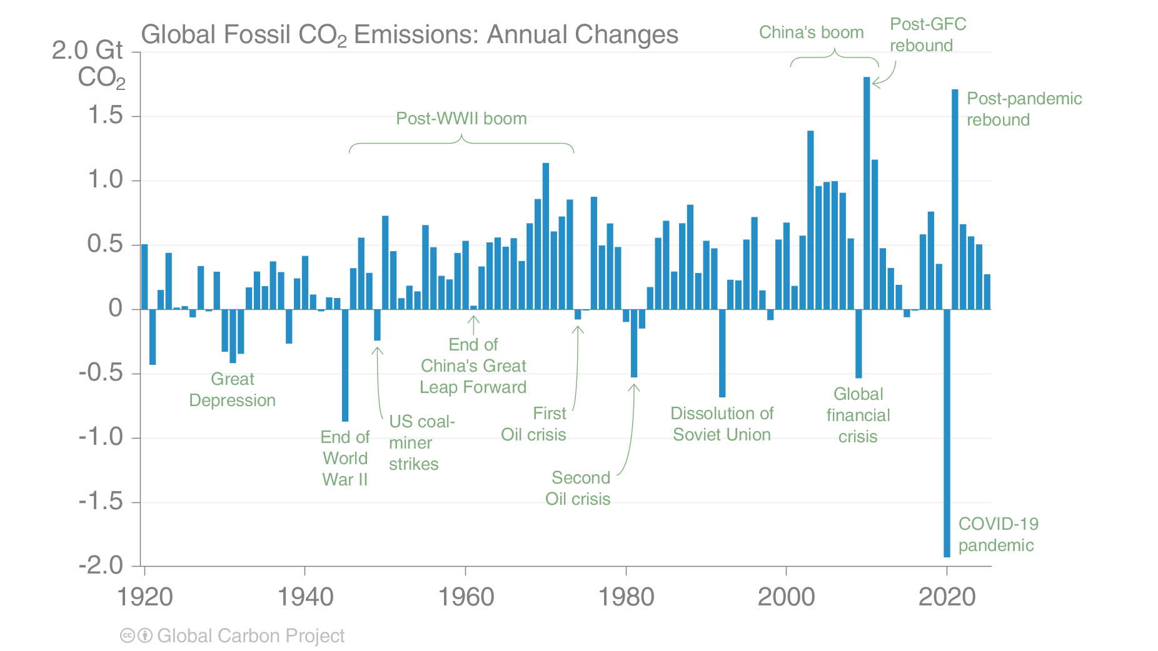
Global fossil CO₂ emissions
For the last 100 years, it has generally taken a crisis to drive global emissions reductions.
To stabilise temperatures, intentional, planned, sustained global reductions must begin.
The 2025 projection is based on preliminary data and modelling.
Source: Friedlingstein et al 2025; Global Carbon Project 2025

Slide 23
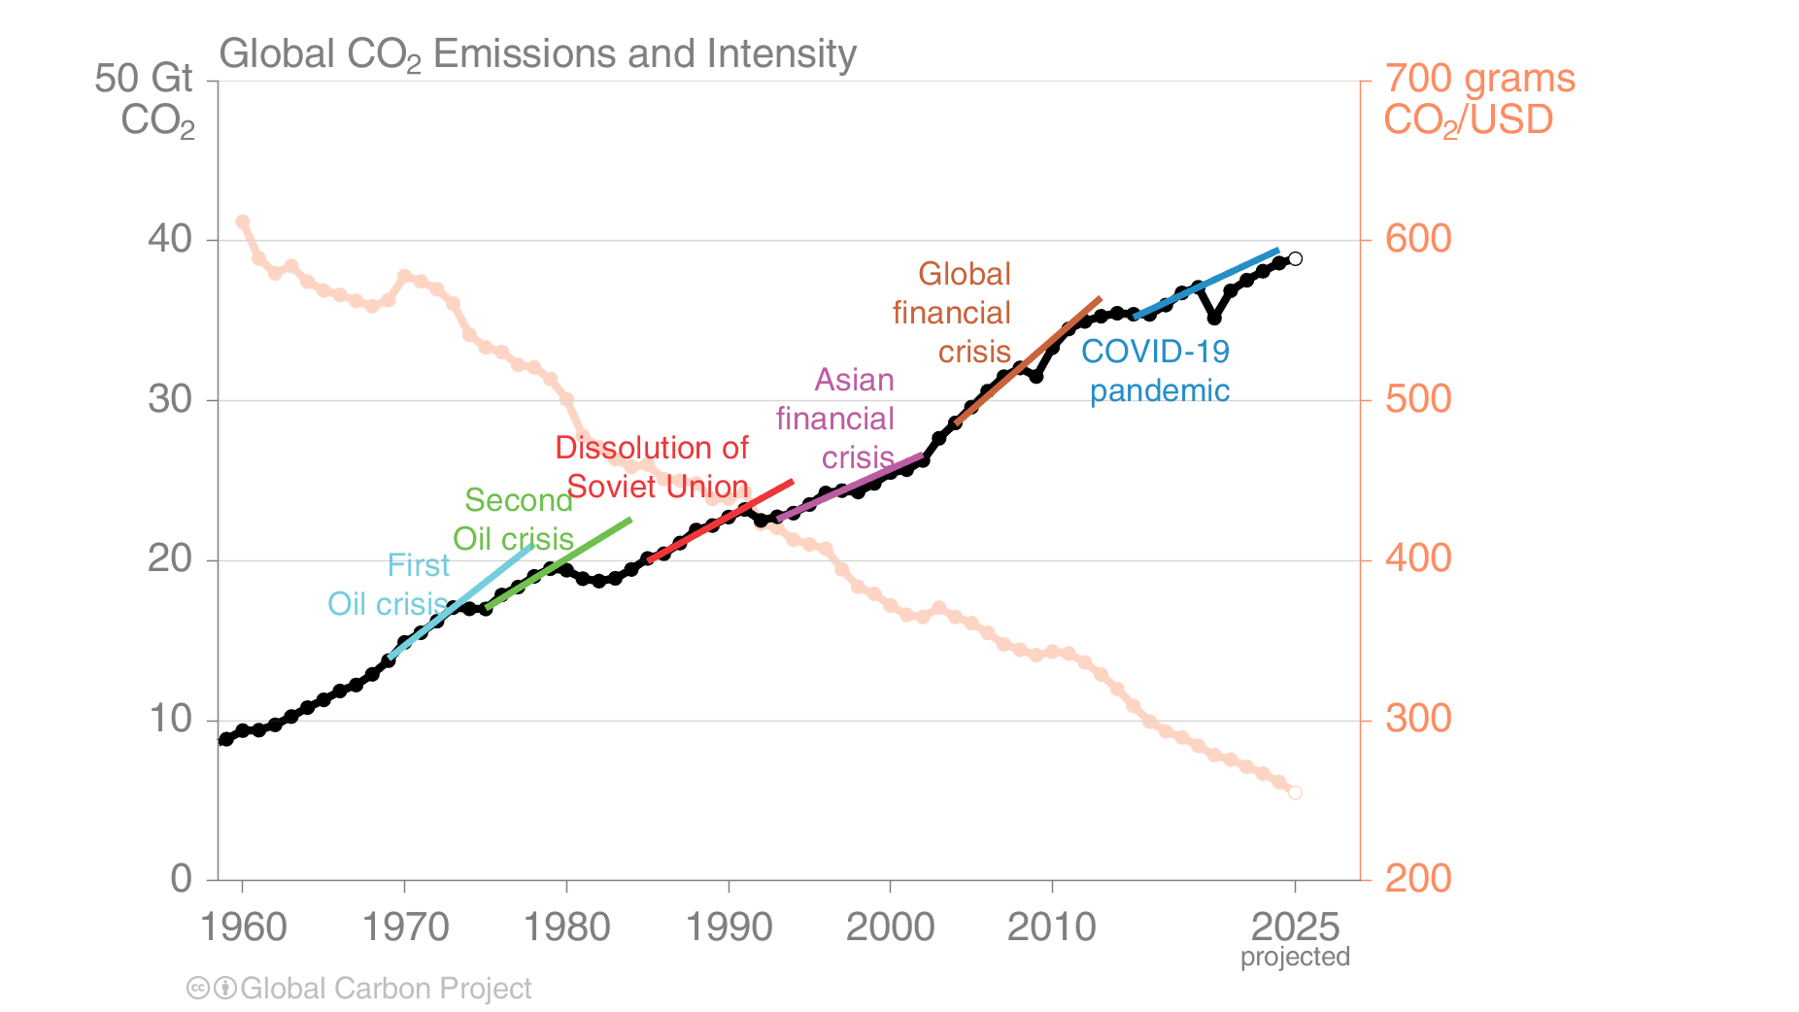
Fossil CO₂ emission intensity
Global CO₂ emissions growth has generally resumed quickly from global crises.
Emission intensity has steadily declined but not sufficiently to offset economic growth.
Each trend line is based on the five years before the crisis and extended to five years after.
Economic activity is measured in purchasing power parity (PPP) terms in 2017 US dollars.
Source: Friedlingstein et al 2025; Global Carbon Project 2025

Slide 24
Fossil CO₂ emissions by country

Slide 25
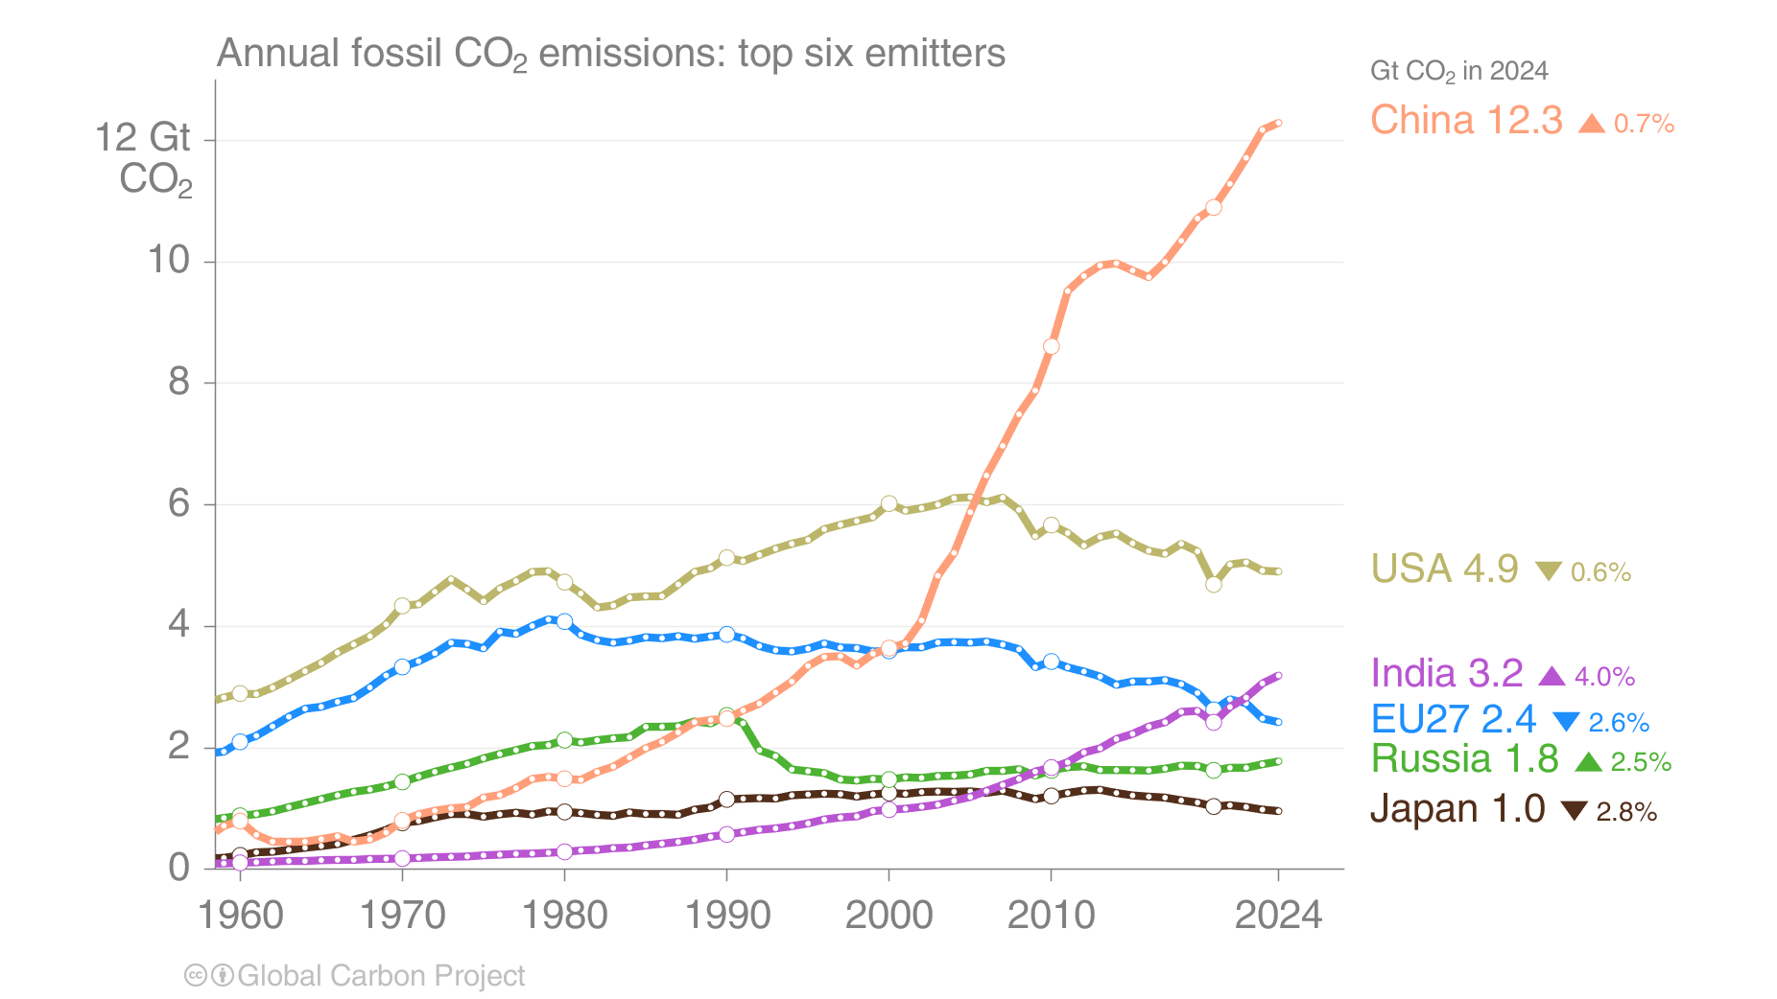
Top emitters: Fossil CO₂ emissions to 2024
The top six emitters in 2024 covered 66% of global emissions
China 32%, United States 13%, India 8%, EU 6%, Russia 5%, and Japan 2%
International aviation and maritime shipping (bunker fuels) contributed 3.1% of global emissions in 2024.
Source: Friedlingstein et al 2025; Global Carbon Project 2025

Slide 26
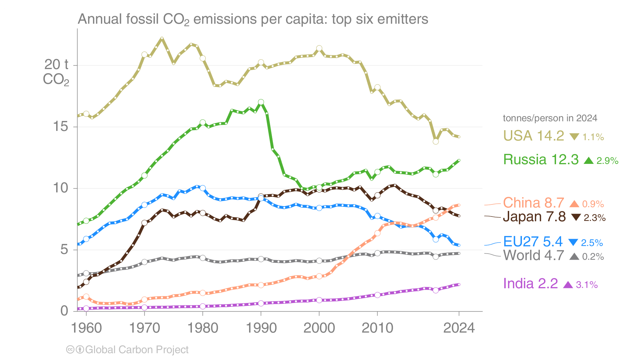
Top emitters: Fossil CO₂ emissions per capita to 2024
Countries have a broad range of per capita emissions reflecting their national circumstances
International aviation and maritime shipping (bunker fuels) contributed 3.1% of global emissions in 2024.
Source: Friedlingstein et al 2025; Global Carbon Project 2025

Slide 27
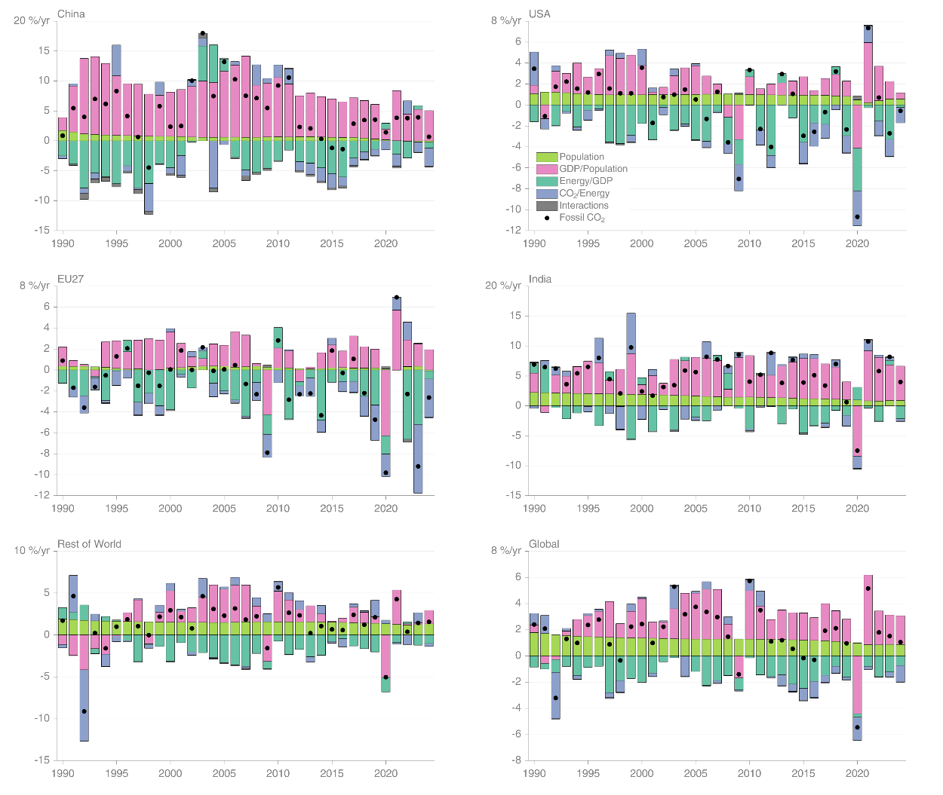
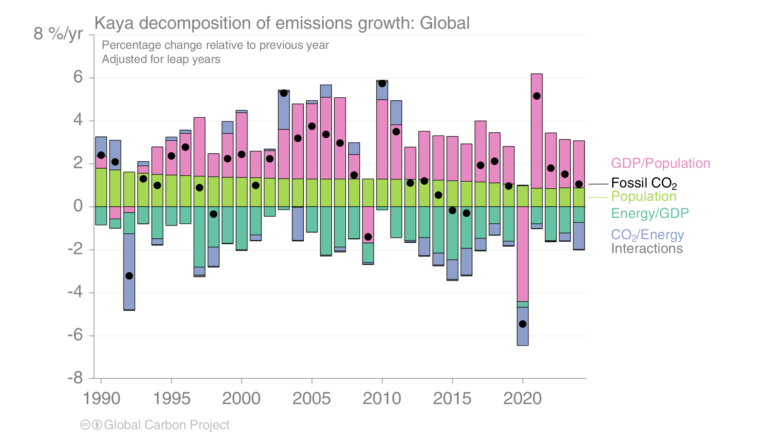
Fossil CO₂ emissions — Kaya decomposition
Globally, decarbonisation and declines in energy per GDP are largely responsible for the reduced growth rate in emissions over the last decade. 2020 was a clear outlier with a sharp decline in GDP.
Source: Friedlingstein et al 2025; Global Carbon Project 2025

Slide 28
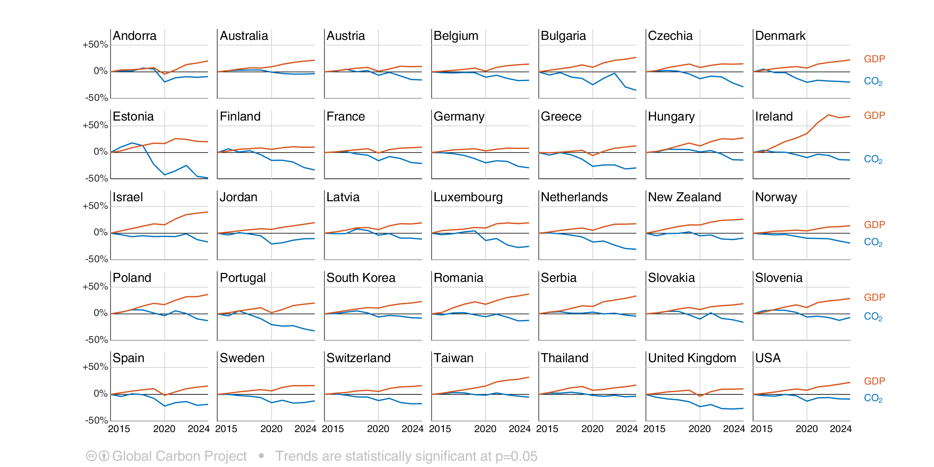
Decarbonisation progress
Fossil CO₂ emissions are declining in 35 countries while economic output is rising (2015–2024)
Source: Friedlingstein et al 2025; Global Carbon Project 2025

Slide 29
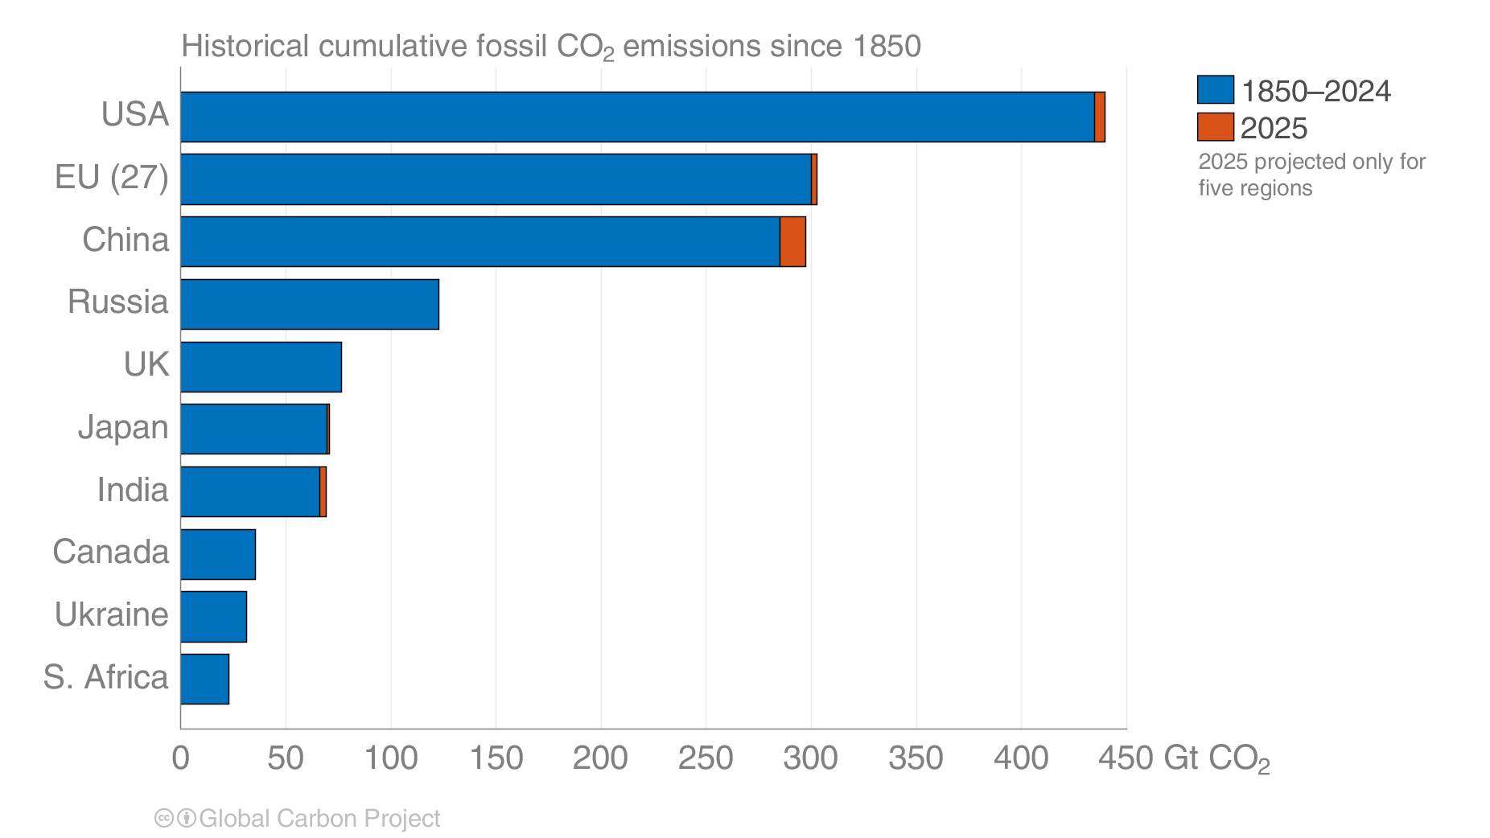
Historical cumulative fossil CO₂ emissions
The USA and EU have the highest accumulated fossil CO₂ emissions since 1850, but China is a close third.
Calculated using territorial emissions.
Source: Friedlingstein et al 2025; Global Carbon Project 2025

Slide 30
Fossil CO₂ emissions by source

Slide 31
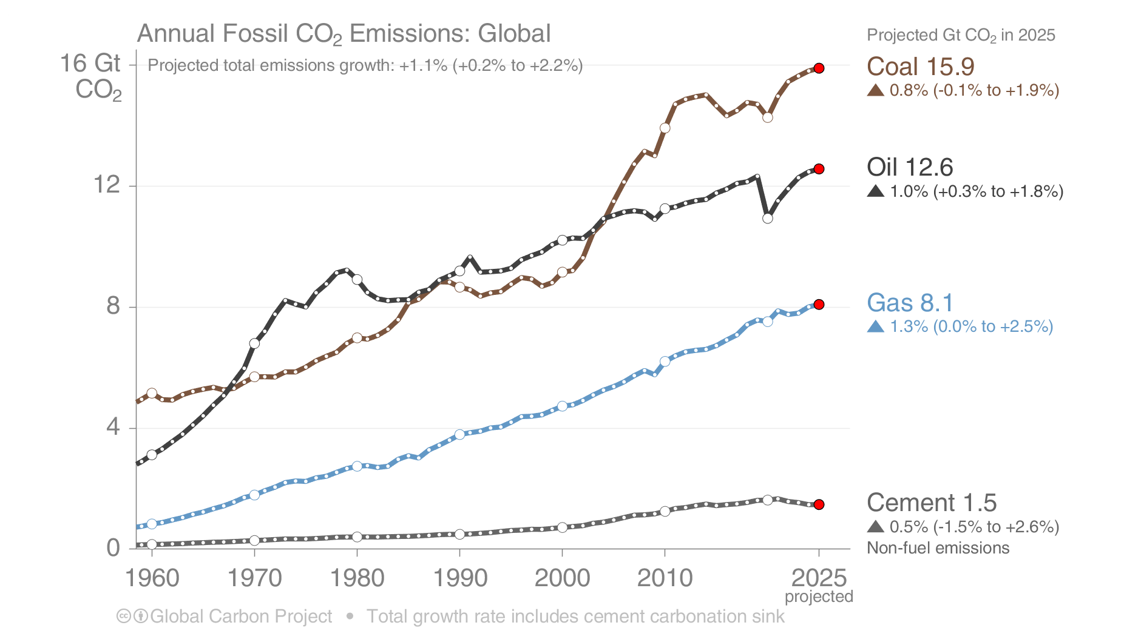
Fossil CO₂ emissions by source
Share of global fossil CO₂ emissions in 2025: coal (41%), oil (32%), gas (21%),
cement (4%), flaring and others (2%, not shown)
The 2025 projection is based on preliminary data and modelling.
Source: Friedlingstein et al 2025; Global Carbon Project 2025

Slide 32
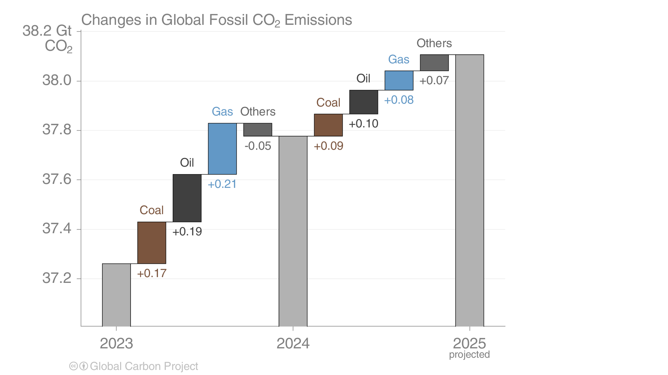
Fossil CO₂ emissions growth: 2023–2025
Global emissions grow in all categories in 2025, but more slowly than in 2024 apart from the “Others” category,
which includes cement, lime, and flaring.
Source: Friedlingstein et al 2025; Global Carbon Project 2025

Slide 33
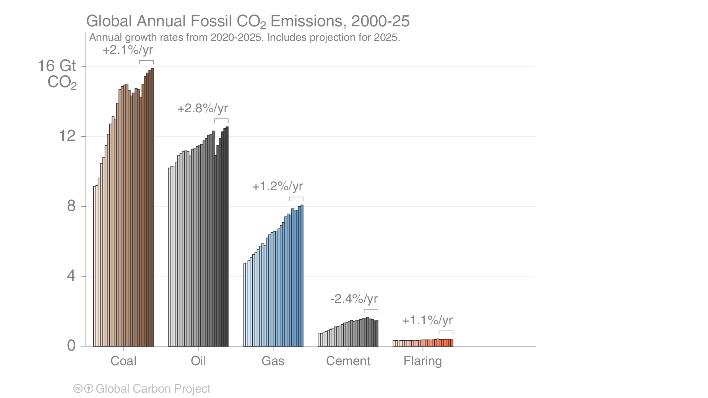
Fossil CO₂ emissions by source
Emissions by category from 2000 to 2025, with growth rates indicated for the more recent period of 2020 to 2025
Both coal and oil declined sharply in the pandemic year 2020, but are at record levels in 2025
Source: Friedlingstein et al 2025; Global Carbon Project 2025

Slide 34
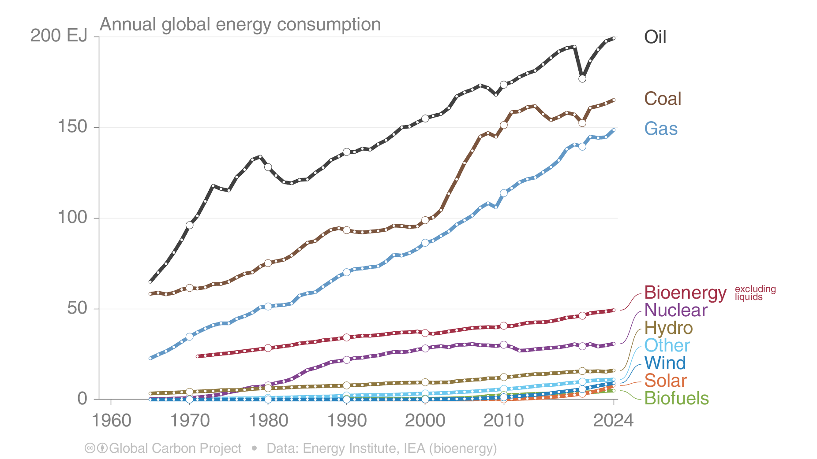
Energy use by source
Consumption of natural gas picked up again in 2024, while oil and coal continue to grow
Renewable energy continued to grow but needs to grow even faster to replace fossil energy consumption.
Data are for Total Energy Supply using Primary Energy accounting (Physical Energy Content method), based on the original data source.
Source: Energy Institute 2025; Global Carbon Project 2025

Slide 35
Fossil CO₂ emission by source for top emitters

Slide 36
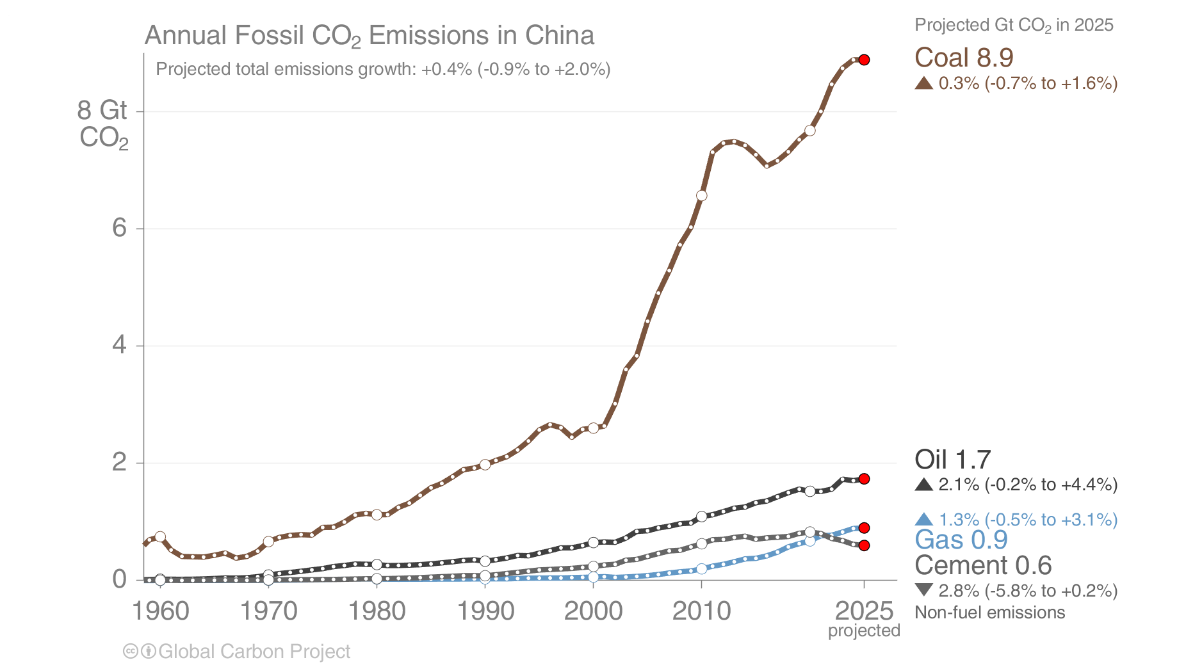
Fossil CO₂ emissions in China
China’s coal consumption was flat in 2025, with only weak growth in oil and gas,
and cement emissions continuing their decline
Source: Friedlingstein et al 2025; Global Carbon Project 2025

Slide 37
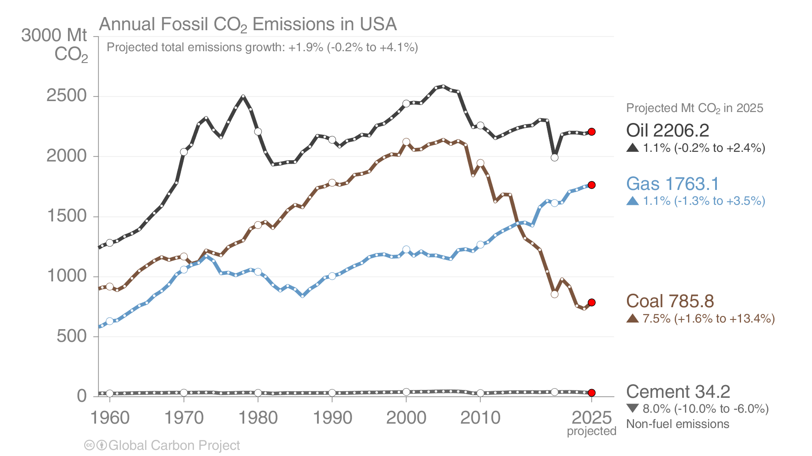
Fossil CO₂ emissions in USA
The USA’s emissions from coal have been declining for many years, and despite an expected rebound in 2025,
are still at their lowest level since 1902. Emissions from oil are still below 2019’s level.
Source: EIA 2025; Friedlingstein et al 2025; Global Carbon Project 2025

Slide 38
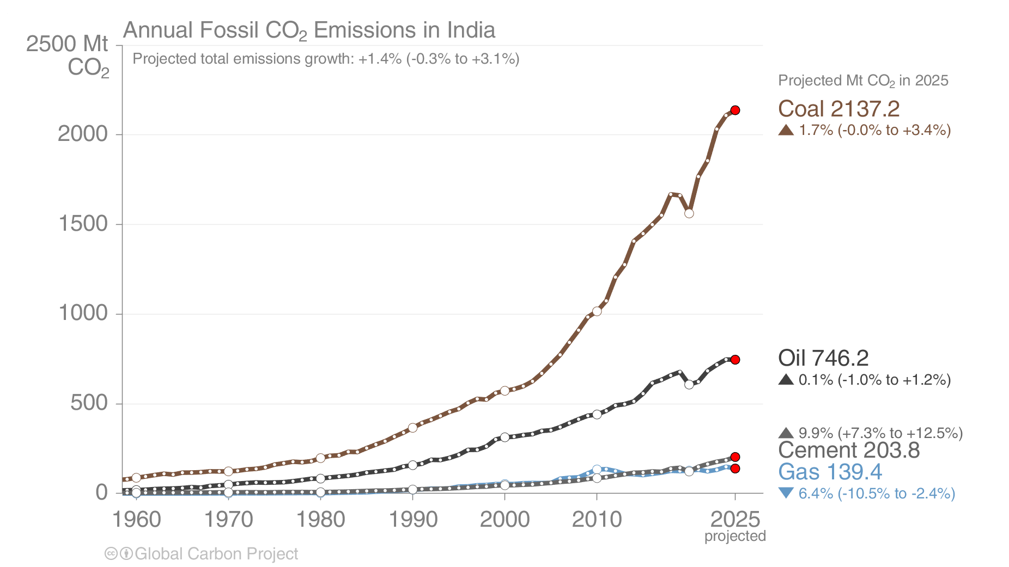
Fossil CO₂ emissions in India
India’s emissions growth dropped in 2025 as an early monsoon reduced
cooling demand and solar capacity grew strongly
Source: Friedlingstein et al 2025; Global Carbon Project 2025

Slide 39
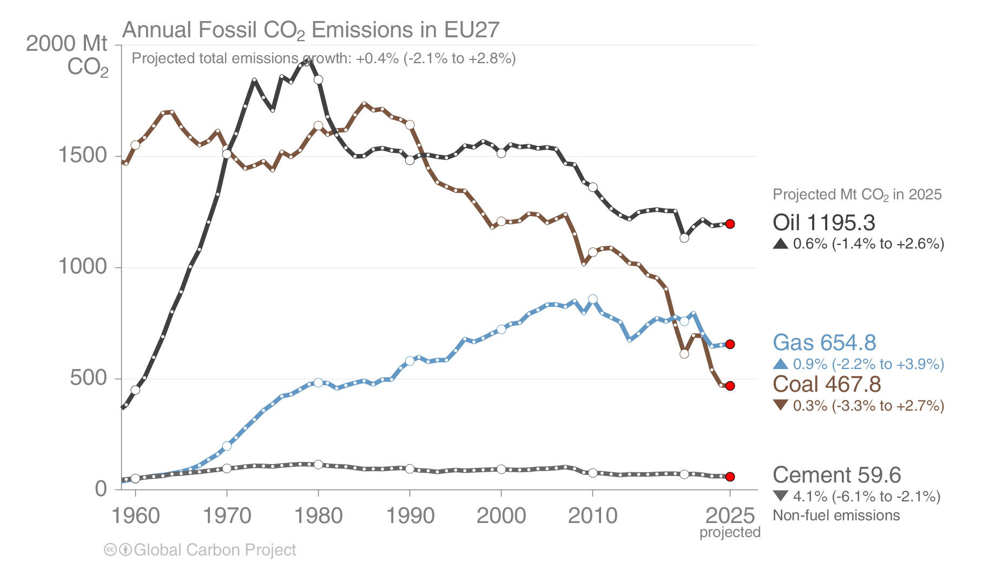
Fossil CO₂ emissions in the European Union
The were only small changes in most categories of the EU’s emissions
The long-term decline in coal was interrupted by weather conditions
Source: Friedlingstein et al 2025; Global Carbon Project 2025

Slide 40
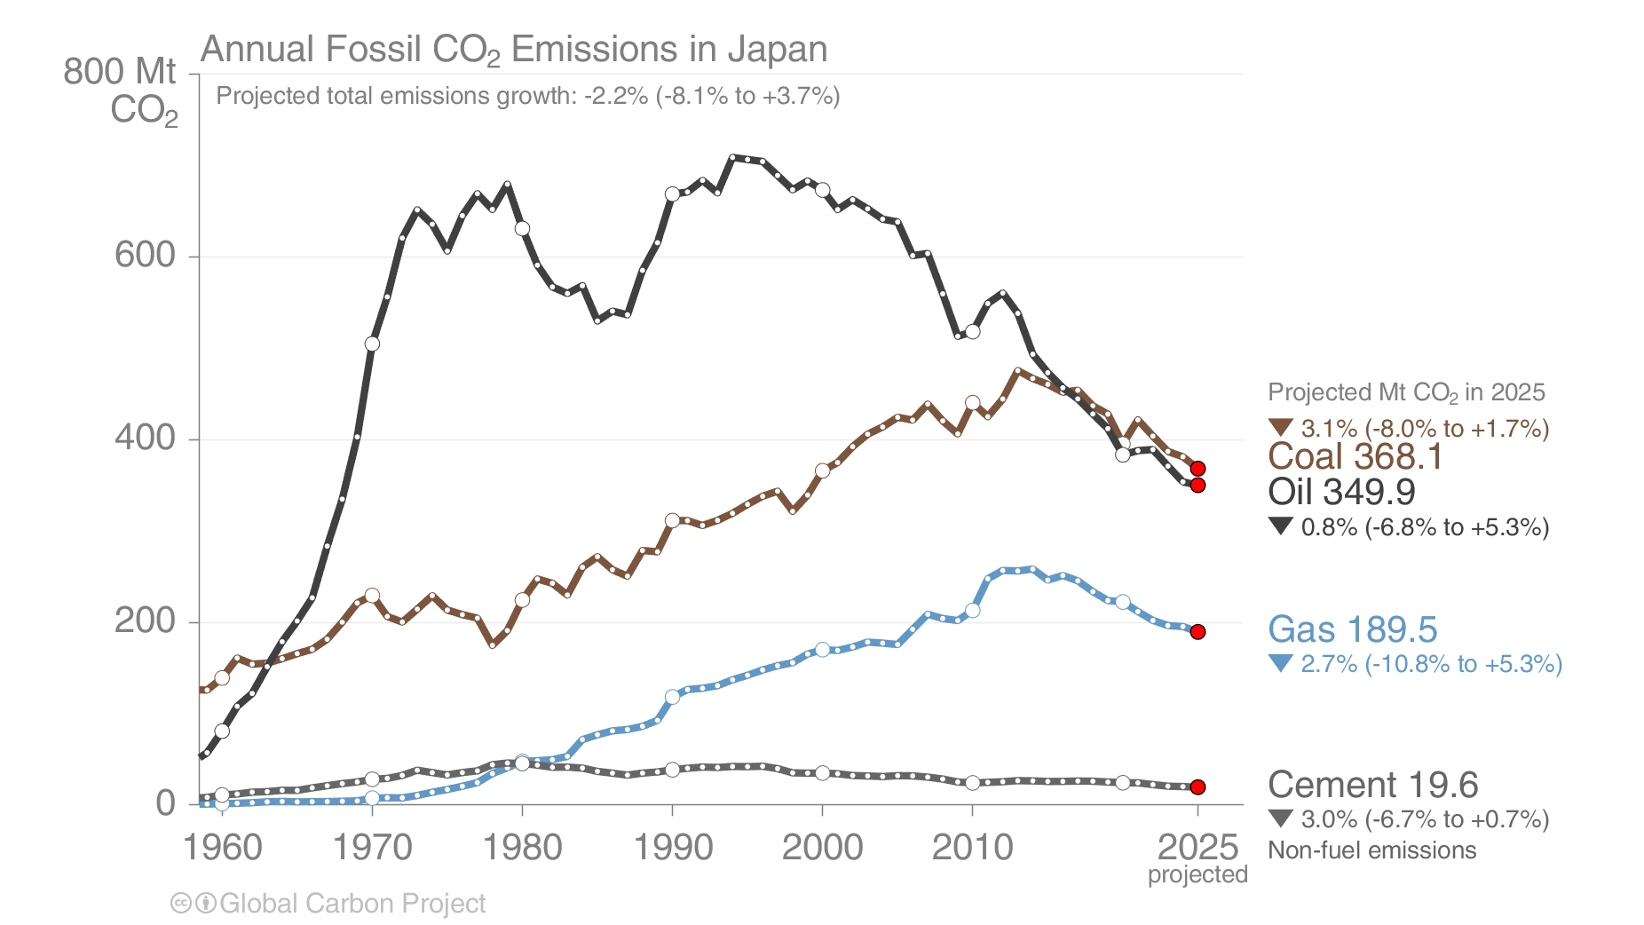
Fossil CO₂ emissions in Japan
Japan’s emissions continue their long decline, with lower emissions in 2025 driven by
further restarts of nuclear reactors and strong growth in solar PV
Source: Friedlingstein et al 2025; Global Carbon Project 2025

Slide 41
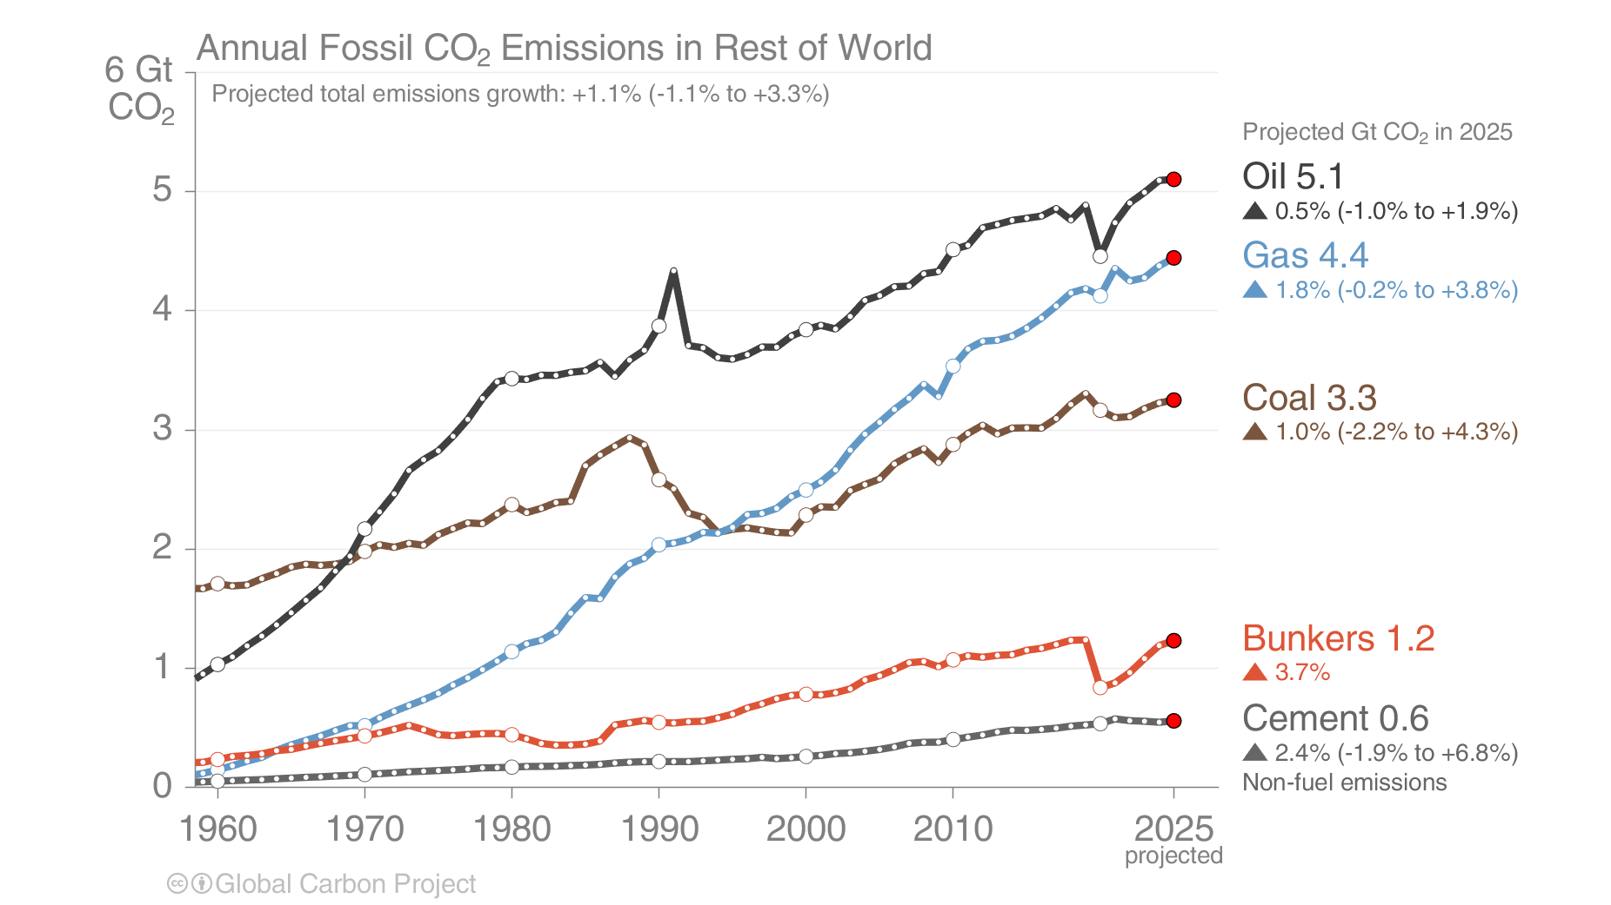
Fossil CO₂ emissions in Rest of World
In the rest of the world, emissions from all categories are growing.
Oil in international aviation grew strongly again, surpassing pre-pandemic levels.
The Rest of the World is the global total less China, US, EU, India, and Japan.
Source: Friedlingstein et al 2025; Global Carbon Project 2025

Slide 42
Cement carbonation sink

Slide 43
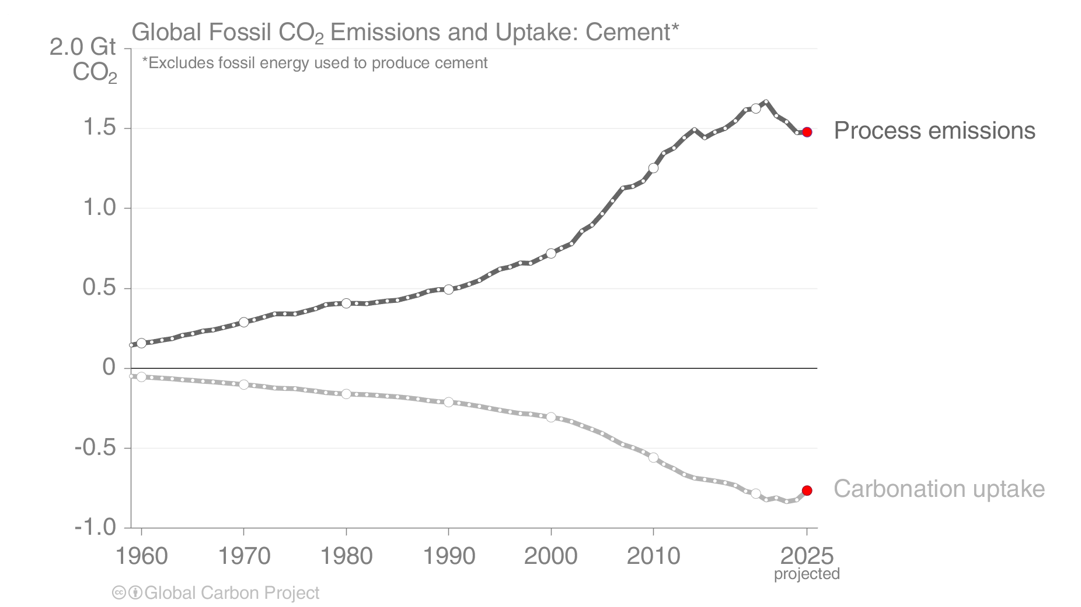
Cement carbonation sink
The production of cement results in ‘process’ emissions of CO₂ from the chemical decomposition of carbonates (a source).
During its lifetime, cement re-absorbs some CO₂ from the atmosphere (a sink).
Source: Friedlingstein et al 2025; Global Carbon Project 2025

Slide 44
Land-use change emissions

Slide 45
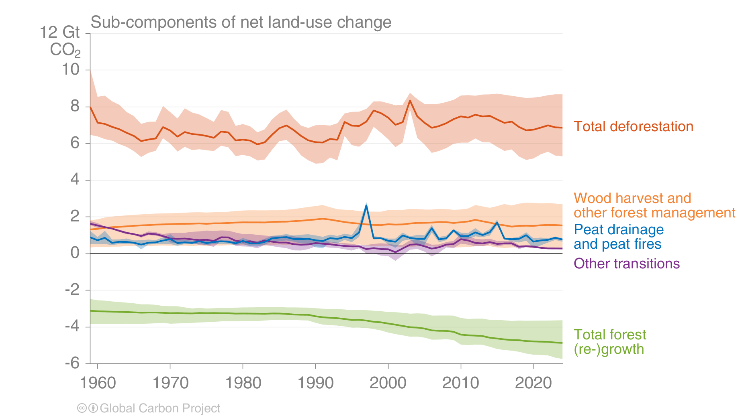
Land-use change emissions
Land-use change emissions were 5.0 ± 2.6 GtCO₂ per year for 2015–2024 and show a negative trend in the last two decades, but estimates are still highly uncertain.
Net land-use emissions are the result of multiple anthropogenic activities on land that lead to CO₂ emissions or removals
Indonesian fires
Projection for 2025:
4.1 ± 2.6 GtCO₂
Estimates from three bookkeeping models
Source: Friedlingstein et al 2025; Global Carbon Project 2025

Slide 46
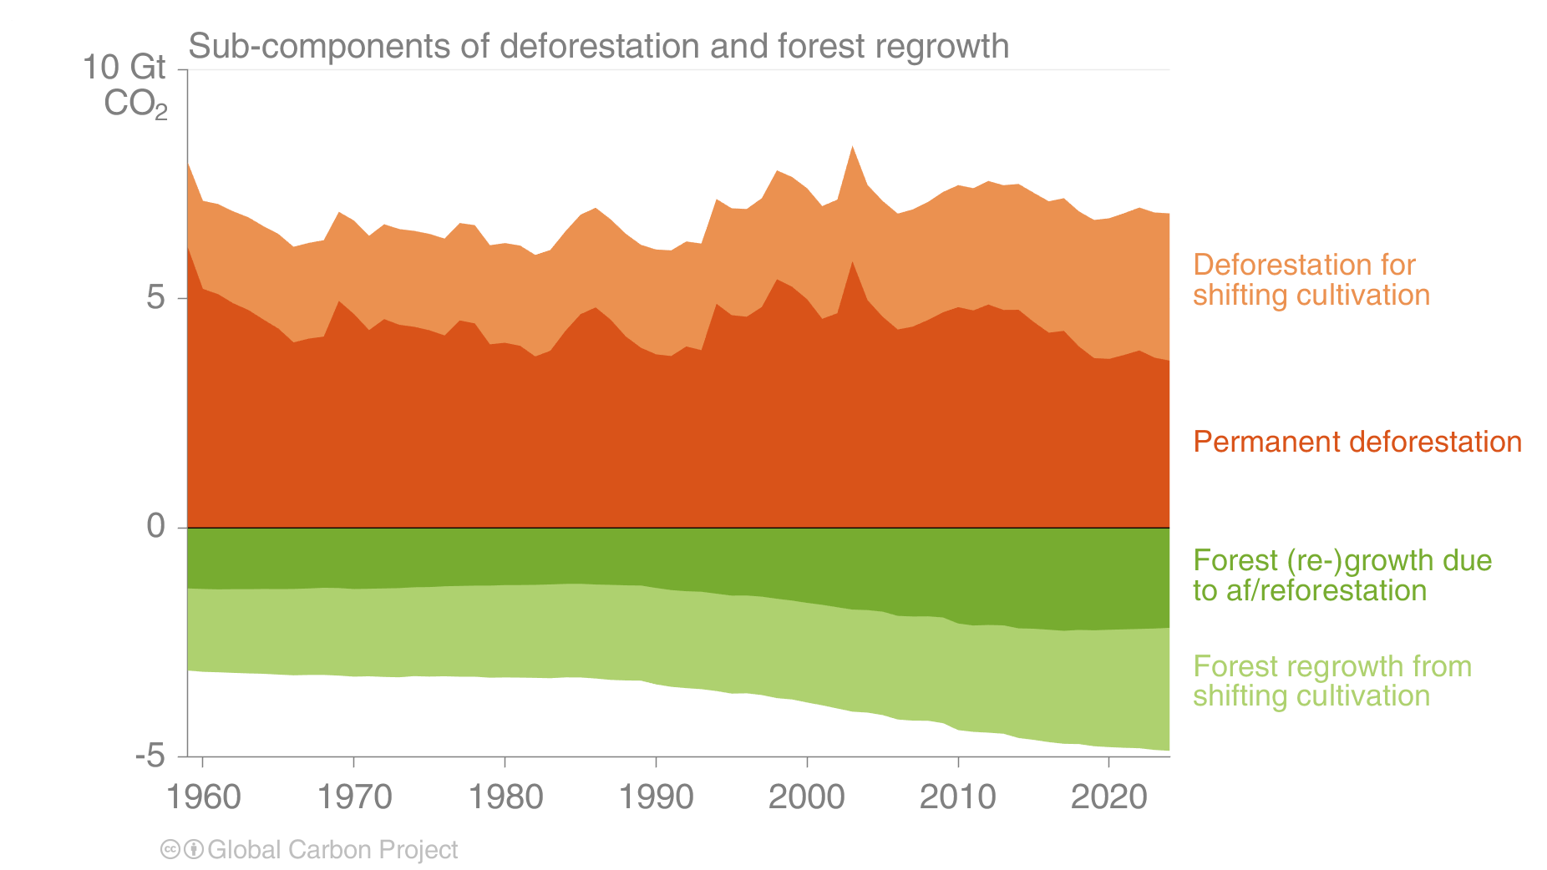
Land-use change emissions
Annual emissions from permanent deforestation declined over 2015–2024 but remain high at around 3.9 GtCO₂.
Carbon dioxide removals through permanent af/reforestation are 2.2 GtCO₂ per year over the same period.
Estimates from three bookkeeping models
Source: Friedlingstein et al 2025; Global Carbon Project 2025

Slide 47
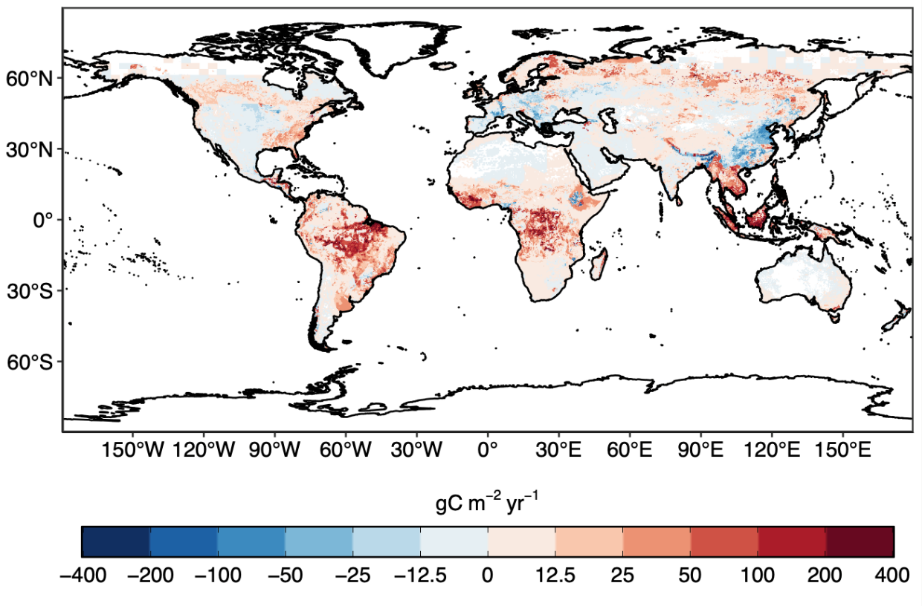
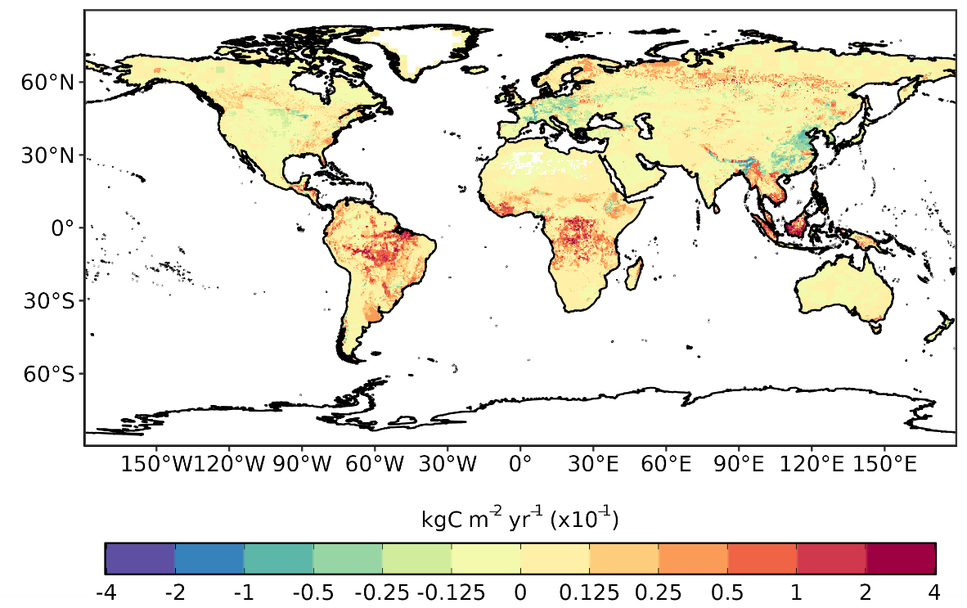
Regional patterns of land-use change emissions
The top three emitters over 2015–2024 – Brazil, Indonesia, and the Democratic Republic of the Congo – contribute more than half of the global net land-use emissions, while China is now the largest remover.
Land-use emissions are high in the tropics, driven largely by deforestation. Net sinks occur in regions of re/afforestation such as parts of Europe and China.
Land-use emissions, decadal average 2015–2024
Estimates from three bookkeeping models
Source: Friedlingstein et al 2025; Global Carbon Project 2025
The peak in Indonesia in 1997 was the Indonesian peat fires.

Slide 48
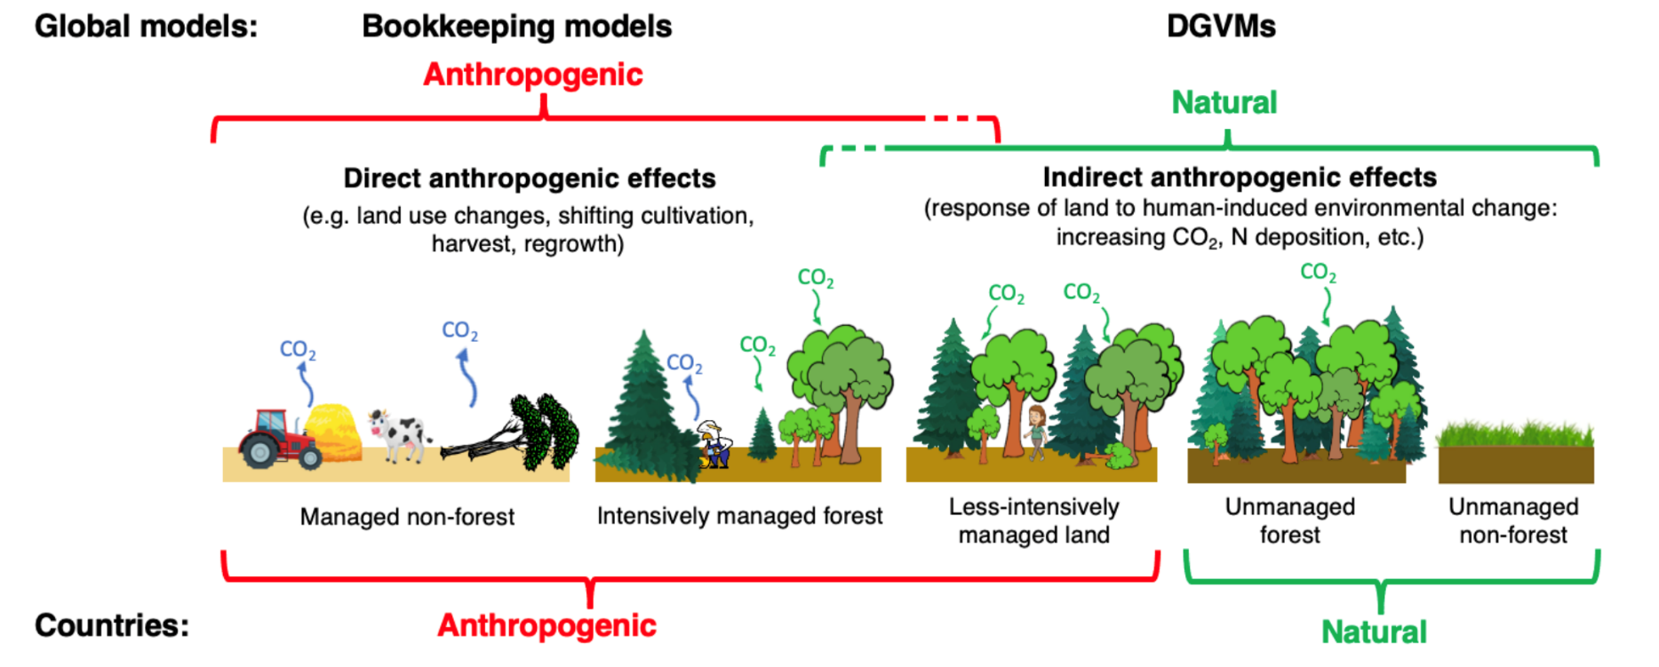
Linking global models to country reports
Mapping of global carbon cycle model land flux definitions to the definition of the LULUCF net flux used in national Greenhouse Gas Inventories (NGHGI) reported to UNFCCC
When natural fluxes on managed forests (-6.9 GtCO₂ per year for 2014–2023) are added to land-use emissions (5.0 GtCO₂ per year), the GCB2025 estimates (-1.9 GtCO₂ per year) are closer to the country-reported data (-3.8 GtCO₂ per year), linking the anthropogenic carbon budget estimates of land CO₂ fluxes directly to the Global Stocktake as part of UNFCCC Paris Agreement.
Source: Friedlingstein et al 2025; Global Carbon Project 2025
Figure from Grassi et al., ESSD 2023

Slide 49
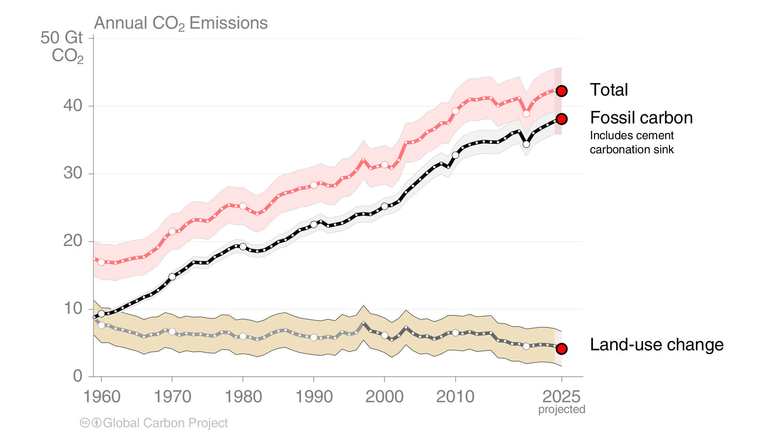
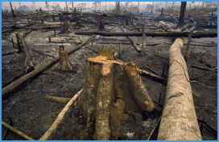
Total global emissions
Total global emissions, projected to reach 42.2 ± 3.2 GtCO₂ in 2025, 49% over 1990
Percentage land-use change: 45% in 1960, 12% averaged 2015–2024
Land-use change estimates from four bookkeeping models, using fire-based variability from 1997
Source: Friedlingstein et al 2025; Global Carbon Project 2025

Slide 50
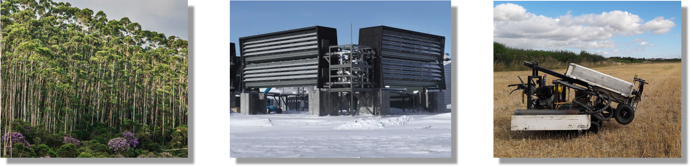
Carbon Dioxide Removal
Equivalent to ~5% of annual Fossil CO₂ emissions
Equivalent to ~1 millionth of annual Fossil CO₂ emissions
2.2 GtCO₂ per year
0.001 MtCO₂ per year
0.007 MtCO₂ per year
Vegetation-based CDR estimates from GCB2025
CDR not based on vegetation from the State of CDR report (2024)

Slide 51
Closing the Global Carbon Budget

Slide 52


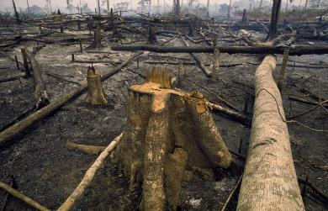

Fate of anthropogenic CO₂ emissions (2015–2024)
Sources = Sinks
20.4 GtCO₂/yr
50%
35.9 GtCO₂/yr
88%
21%
8.7 GtCO₂/yr
12%
5.0 GtCO₂/yr
29%
11.8 GtCO₂/yr
Budget Imbalance:
(the difference between estimated sources & sinks)
<1%
0.1 GtCO₂/yr
Source: Friedlingstein et al 2025; Global Carbon Project 2025

Slide 53
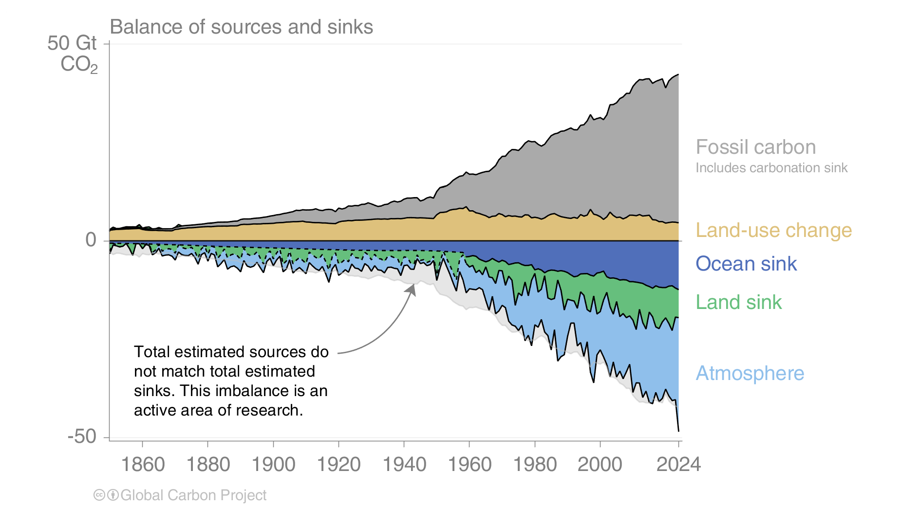
Global carbon budget
Carbon emissions are partitioned among the atmosphere and carbon sinks on land and in the ocean
The “imbalance” between total emissions and total sinks is an active area of research
Source: Friedlingstein et al 2025; Global Carbon Project 2025

Slide 54
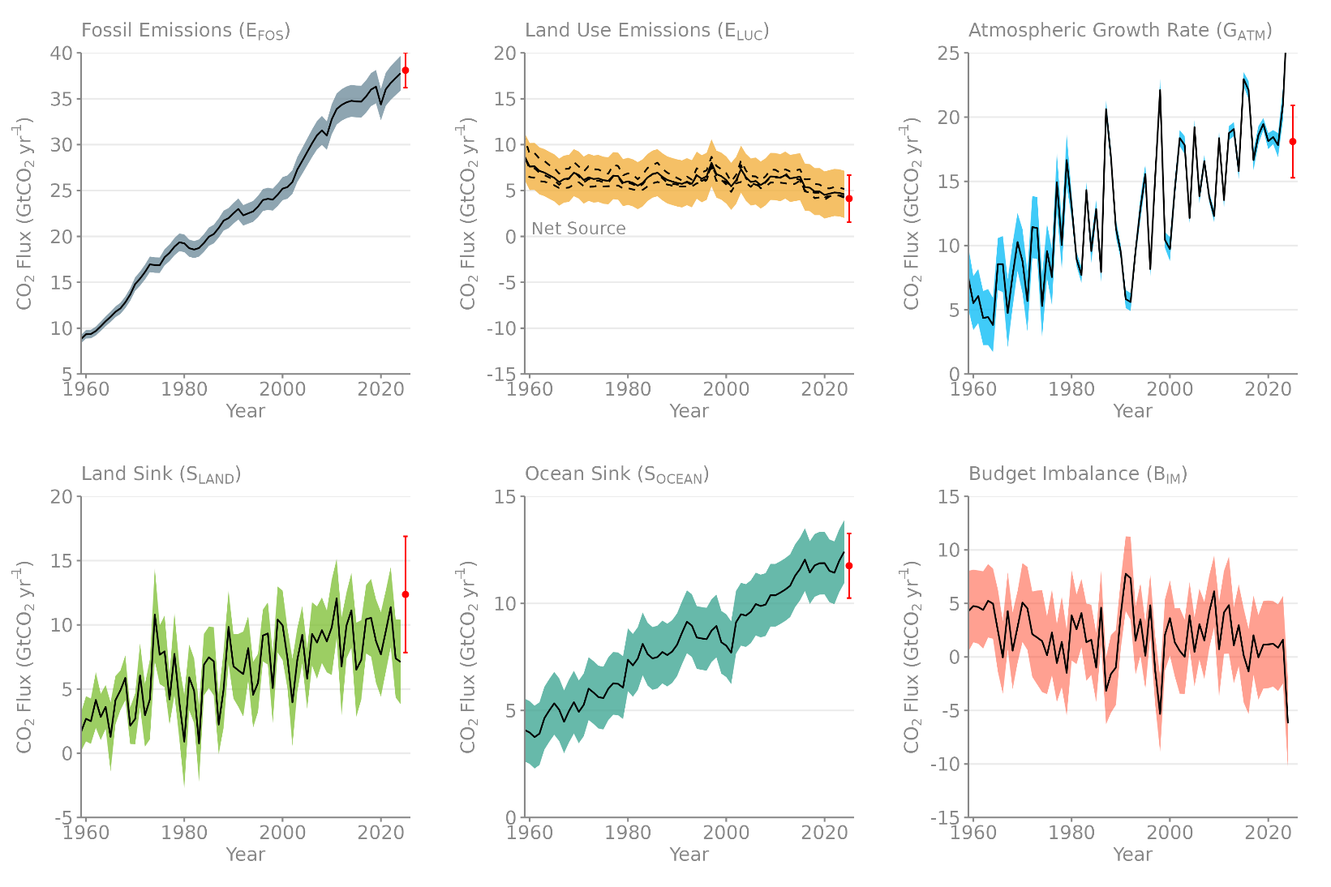
Changes in the budget over time
The sinks have continued to grow with increasing emissions, but climate change affects
carbon cycle processes in a way that will exacerbate the increase of CO₂ in the atmosphere
The budget imbalance is the total emissions minus the estimated growth in the atmosphere, land and ocean.
It reflects the limits of our understanding of the carbon cycle.
Source: Friedlingstein et al 2025; Global Carbon Project 2025

Slide 55
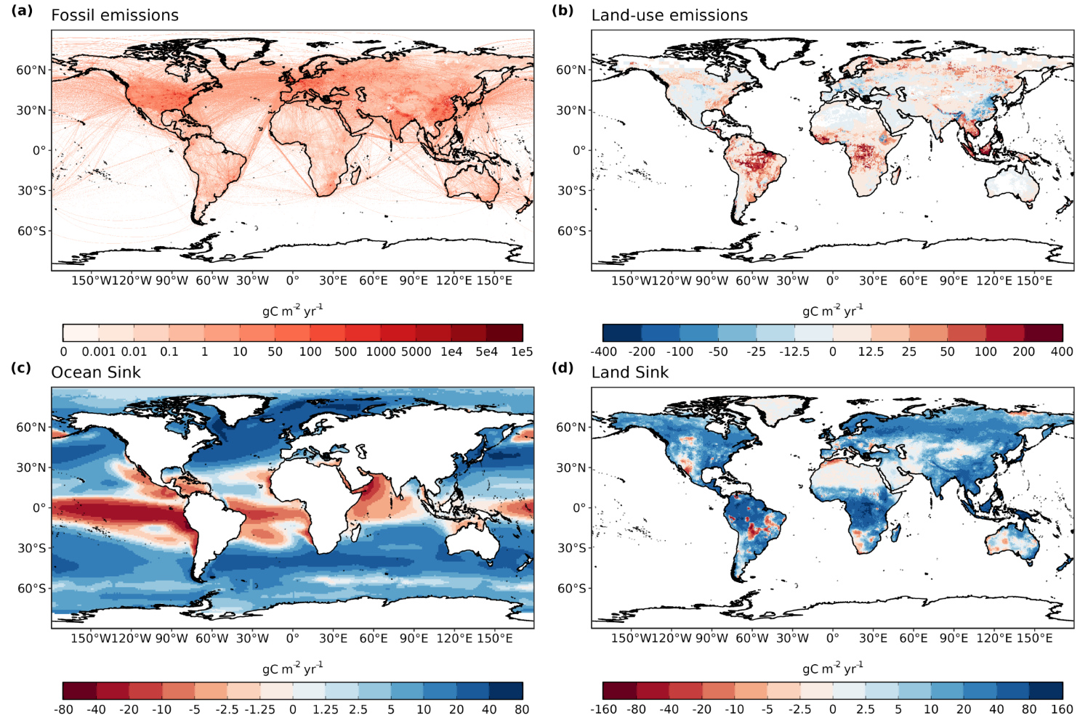
Global carbon budget
Fossil emissions dominate in the Northern Hemisphere, while land-use emissions are important in the tropics.
The North Atlantic and Southern Ocean are carbon sinks while the tropical ocean is a source of CO₂.
Tropical, temperate and boreal forest are the main terrestrial carbon sinks
CO₂ Sink
CO₂ Source
CO₂ Source
CO₂ Sink
CO₂ Source
CO₂ Sink
Source: Friedlingstein et al 2025; Global Carbon Project 2025

Slide 56
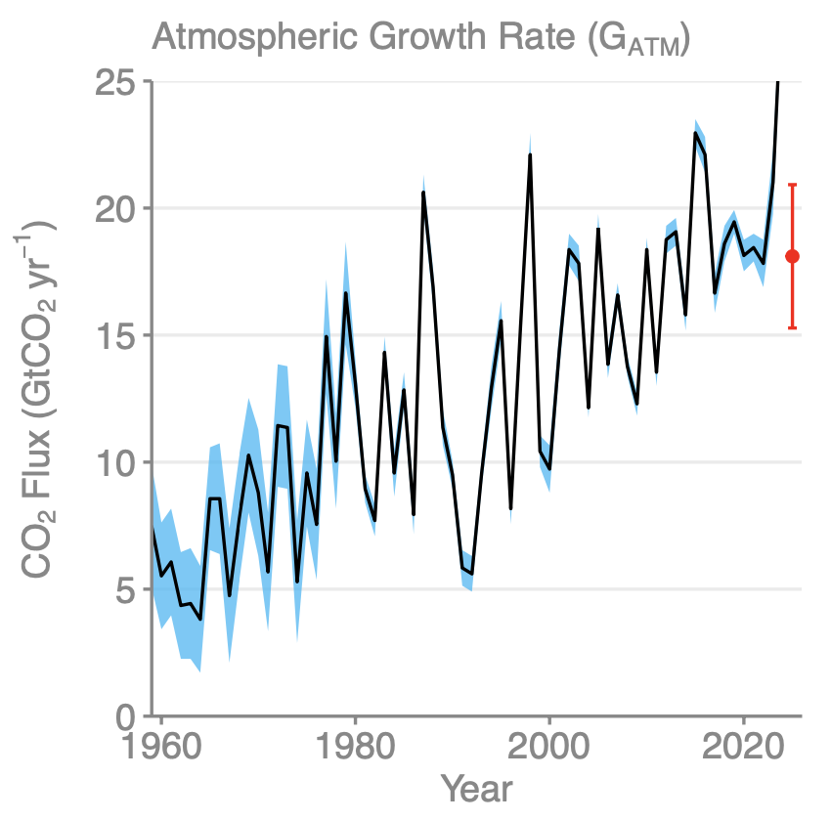
Atmospheric concentration
The atmospheric concentration growth rate has increased steadily.
The high growth in 1997-98, 2015–16 and 2023-24 reflect a strong El Niño, which weakens the land sink.
The 2025 growth rate is expected to return to pre-El Niño level
Projected 2025
Source: NOAA-GML; Friedlingstein et al 2025; Global Carbon Project 2025

Slide 57
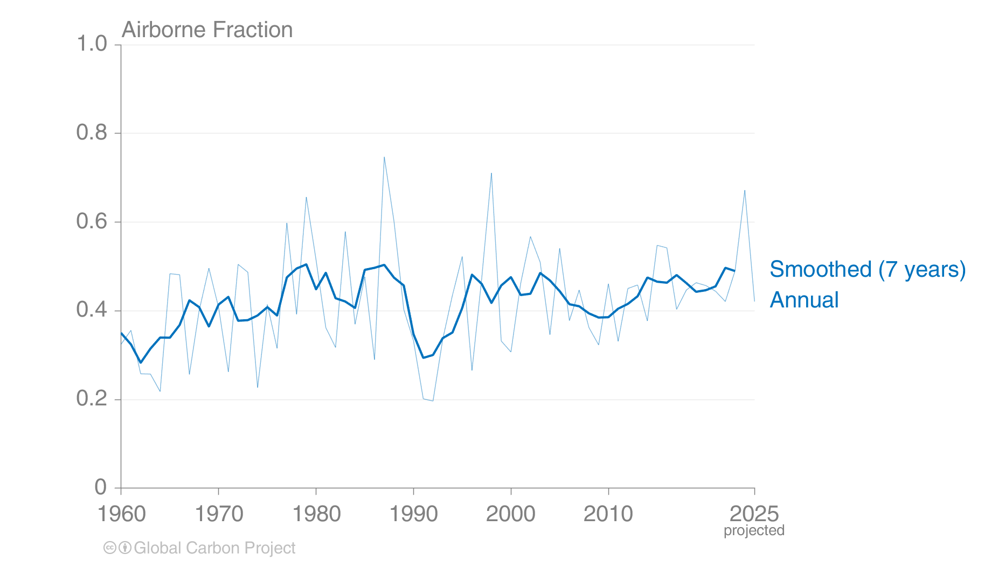
Airborne Fraction
The airborne fraction is the proportion of the total annual CO₂ emissions that remains in the atmosphere.
The rest of the CO₂ emissions are removed by the land and ocean sinks.
Around 45% of CO₂ emissions remain in the atmosphere despite sustained growth in CO₂ emissions.
Source: Friedlingstein et al 2025; Global Carbon Project 2025

Slide 58
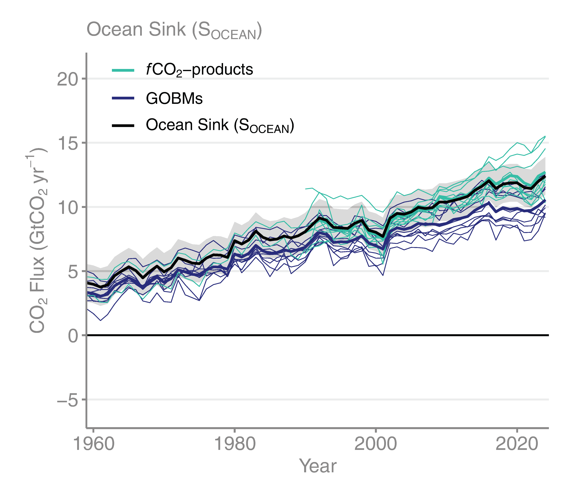
Ocean sink
The ocean carbon sink, estimated by Global Ocean Biogeochemical Models and observation-based data products,
amounts to 11.8 ± 1.5 GtCO₂/yr for 2015–2024 and 12.4 ± 1.5 GtCO₂/yr in 2024.
The ocean sink increased in 2024, in line with the expected sink response to the 2023-24 El Niño conditions.
Source: SOCATv2023; Bakker et al 2016; Friedlingstein et al 2025; Global Carbon Project 2025

Slide 59

Terrestrial sink
The land carbon sink, estimated by Dynamic Global Vegetation Models, was
8.7 ± 3.2 GtCO₂/yr during 2015–2024. The effects of 2023-24 El Niño reduced the
land CO₂ sink to 7.1 GtCO₂ in 2024, 18% below its decadal mean.
Source: Friedlingstein et al 2025; Global Carbon Project 2025

Slide 60

Land and ocean sinks — Effects of CO₂ vs climate change
Process models suggest that increasing atmospheric CO₂ drives the land and ocean sinks while climate change reduces the carbon sinks. On average for the 2015-2024 period, the land and ocean CO₂ sink are respectively 25% and 7% smaller than what they would have been without the effects of climate change and variability
CO₂ Sink
CO₂ Source
Source: Friedlingstein et al 2025; Global Carbon Project 2025

Slide 61

Land and ocean sinks — The 2023–2024 El Niño
The 2023–2024 El Niño conditions led to a large reduction of the land carbon sink, particularly in the tropics with a 66% reduction relative to the pre-El Niño (2022) land sink.
The ocean sink was slightly larger in 2024 than in 2023, primarily due to the high atmospheric CO₂ growth rate in 2024.
Source: Friedlingstein et al 2025; Global Carbon Project 2025

Slide 62

Land and ocean sinks — Estimates from atmospheric inversions
Both atmospheric CO₂ inversions and atmospheric oxygen allow to estimate the land and ocean carbon fluxes, independently from the land and ocean process-based models, confirming the global carbon budget estimates of the land and ocean partitioning of anthropogenic CO₂
Source: Friedlingstein et al 2025; Global Carbon Project 2025

Slide 63

Total land and ocean fluxes
Bottom-up estimates and top-down atmospheric inversions broadly agree on the land and ocean sinks at large regional scales.
The interannual variability in the global total CO₂ flux is largely due to the variability of the land sink in the tropics.
Source: Friedlingstein et al 2025; Global Carbon Project 2025

Slide 64

Remaining carbon budget imbalance
Large and unexplained variability in the global carbon balance caused by uncertainty
and understanding hinder independent verification of reported CO₂ emissions
positive values mean overestimated emissions and/or underestimated sinks
The budget imbalance is the carbon left after adding independent estimates for total emissions, minus the
atmospheric growth rate and estimates for the land and ocean carbon sinks using models constrained by observations
Source: Friedlingstein et al 2025; Global Carbon Project 2025

Slide 65

Global carbon budget
The cumulative contributions to the global carbon budget from 1850
The carbon imbalance represents the gap in our current understanding of sources & sinks
Source: Friedlingstein et al 2025; Global Carbon Project 2025

Slide 66

Remaining carbon budget
The remaining carbon budget to limit global warming to 1.5°C , 1.7°C and 2°C is
170 GtCO₂, 525 GtCO₂, and 1055 GtCO₂ respectively, equivalent to 4, 12 and 25 years from 2026.
A total of 2770 GtCO₂ has been emitted since 1850.
The remaining carbon budgets are the average of two estimates (IPCC AR6 and Forster et al., 2025), both updated by removing the most recent emissions.
Quantities are subject to additional uncertainties e.g., future mitigation choices of non-CO₂ emissions
Source: IPCC AR6 WG1; Forster et al., 2023; Friedlingstein et al 2025; Global Carbon Project 2025

Slide 67

Remaining carbon budget
Global CO₂ emissions must reach zero to limit global warming.
All-else-equal, the later the net zero year, the higher the warming level.
Source: Friedlingstein et al 2025; Global Carbon Project 2025

Slide 68
Acknowledgements

Slide 69











Acknowledgements
The work presented in the Global Carbon Budget 2025 has been possible thanks to the contributions of hundreds of people involved in observational networks, modelling, and synthesis efforts.
We thank the institutions and agencies that provide support for individuals and funding that enable the collaborative effort of bringing all components together in the carbon budget effort.
We thank the sponsors of the GCP and GCP support and liaison offices.
We also want to thank the many funding agencies that supported this coordinated effort and the individual components of this release. A full list is provided in Friedlingstein et al. 2025, (available on November 13th):
https://doi.org/10.18160/GCP-2025
We also thank the Fondation BNP Paribas for supporting the Global Carbon Atlas and the Integrated Carbon Observation System (ICOS) for hosting our data.
This presentation was created by Robbie Andrew, Pierre Friedlingstein, Glen Peters, Julia Pongratz, and Corinne Le Quéré in support of the international carbon research community.

Slide 70
Additional Figures

Slide 71
Additional Figures
Fossil CO₂

Slide 72

Emissions changes 2023–2025
Emissions from coal in China and India have been a core reason for global growth, but in 2025 this growth is low.
Both 2023 and 2024 were marked by post-pandemic recovery in international aviation (bunkers).
Source: Friedlingstein et al 2025; Global Carbon Project 2025

Slide 73

Top emitters: Fossil CO₂ Emissions
Emissions by country from 2000 to 2025, with the growth rates
indicated for the more recent period of 2020 to 2025
Source: Friedlingstein et al 2025; Global Carbon Project 2025

Slide 74

Per capita CO₂ emissions
Source: Friedlingstein et al 2025; Global Carbon Project 2025

Slide 75

Top emitters: Fossil CO₂ Emission Intensity
Emission intensity (emission per unit economic output) generally declines over time.
In many countries, these declines are insufficient to overcome economic growth.
GDP is measured in purchasing power parity (PPP) terms in 2017 US dollars.
Source: Friedlingstein et al 2025; Global Carbon Project 2025

Slide 76

Kaya decomposition
The Kaya decomposition illustrates that relative decoupling of economic growth from CO₂ emissions
is driven by improved energy intensity (Energy/GDP) and, recently, carbon intensity of energy (CO₂/Energy)
GDP: Gross Domestic Product (economic activity)
Source: Friedlingstein et al 2025; Global Carbon Project 2025

Slide 77

Fossil CO₂ emission intensity
The 10 largest economies have a wide range of emission intensity of economic activity
Emission intensity: Fossil CO₂ emissions divided by Gross Domestic Product (GDP)
Source: Friedlingstein et al 2025; Global Carbon Project 2025

Slide 78

Fossil CO₂ Emissions per capita
The 10 most populous countries span a wide range of development and emissions per capita
Emission per capita: Fossil CO₂ emissions divided by population
Source: Friedlingstein et al 2025; Global Carbon Project 2025

Slide 79

Alternative rankings of countries
The responsibility of individual countries depends on perspective.
Bars indicate fossil CO₂ emissions, population, and GDP.
GDP: Gross Domestic Product in Market Exchange Rates (MER) and Purchasing Power Parity (PPP)
Source: United Nations; Friedlingstein et al 2025; Global Carbon Project 2025

Slide 80

Breakdown of global fossil CO₂ emissions by country
Source: Friedlingstein et al 2025; Global Carbon Project 2025

Slide 81

Fossil CO₂ emissions by continent
Asia dominates global fossil CO₂ emissions, while emissions in North America
are of similar size to those in Europe, and the Middle East is growing rapidly.
Source: Friedlingstein et al 2025; Global Carbon Project 2025

Slide 82

Fossil CO₂ emissions by continent: per capita
Oceania and North America have the highest per capita emissions, while the Middle East has recently overtaken Europe.
Africa has by far the lowest emissions per capita.
Source: Friedlingstein et al 2025; Global Carbon Project 2025

Slide 83
Additional Figures
Consumption-based Emissions
Consumption–based emissions allocate emissions to the location that goods and services are consumed
Consumption-based emissions = Production/Territorial-based emissions minus emissions embodied in exports plus the emissions embodied in imports

Slide 84

Consumption-based emissions (carbon footprint)
Allocating fossil CO₂ emissions to consumption provides an alternative perspective.
USA and EU are net importers of embodied emissions, China and India are net exporters.
Consumption-based emissions are calculated by adjusting the
standard emissions estimates to account for international trade
Source: Peters et al 2011; Friedlingstein et al 2025; Global Carbon Project 2025

Slide 85

Consumption-based emissions per person
The differences between fossil CO₂ emissions per capita is larger than the
differences between consumption and territorial emissions.
Consumption-based emissions are calculated by adjusting the
standard emissions estimates to account for international trade
Source: Peters et al 2011; Friedlingstein et al 2025; Global Carbon Project 2025

Slide 86

Consumption-based emissions (carbon footprint)
Transfers of emissions embodied in trade between OECD and non-OECD countries grew
slowly during the 2000’s, declined to 2015 and have been relatively flat since then.
Source: Peters et al 2011; Friedlingstein et al 2025; Global Carbon Project 2025

Slide 87
Additional Figures
Historical Emissions

Slide 88

Total global emissions by source
Land-use change was the dominant source of annual CO₂ emissions until around 1950.
Fossil CO₂ emissions now dominate global changes.
Others: Emissions from cement production, gas flaring and carbonate decomposition
Source: Friedlingstein et al 2025; Global Carbon Project 2025

Slide 89

Historical cumulative emissions by source
Others: Emissions from cement production, gas flaring and carbonate decomposition
Source: Friedlingstein et al 2025; Global Carbon Project 2025

Slide 90

Historical cumulative fossil CO₂ emissions by country
‘All others’ includes all other countries along with emissions from international aviation and maritime shipping
Source: Friedlingstein et al 2025; Global Carbon Project 2025

Slide 91

Historical cumulative emissions by continent
Cumulative fossil CO₂ emissions (1850–2024). North America and Europe have
contributed the most cumulative emissions, but Asia is growing fast
The figure excludes emissions from international aviation and maritime shipping
Source: Friedlingstein et al 2025; Global Carbon Project 2025

